Slide 1

FASE Framework for Air-Mobility SoS Evaluation
Victor Petitgenet - (vpetitgenet@gatech.edu)
Alex Ostrow - (aostrow7@gatech.edu)
Nadir Ougazzaden - (nadirougazzaden@gatech.edu)
Kaleb Cornick - (kcornick3@gatech.edu)

Slide 2







Team Members
Academic Advisor
Dr. Mavris
Dr. Christopher Jouannet
Dr. Kristian
Amadori
Research Engineer
Dr. Justin
Graduate Students
Kaleb
Cornick
Alex
Ostrow
Nadir
Ougazzaden
Victor
Petitgenet

Slide 3
Table of Contents
Motivation
Current Methods
Methodology
Implementation
Dashboard
Conclusions

Slide 4

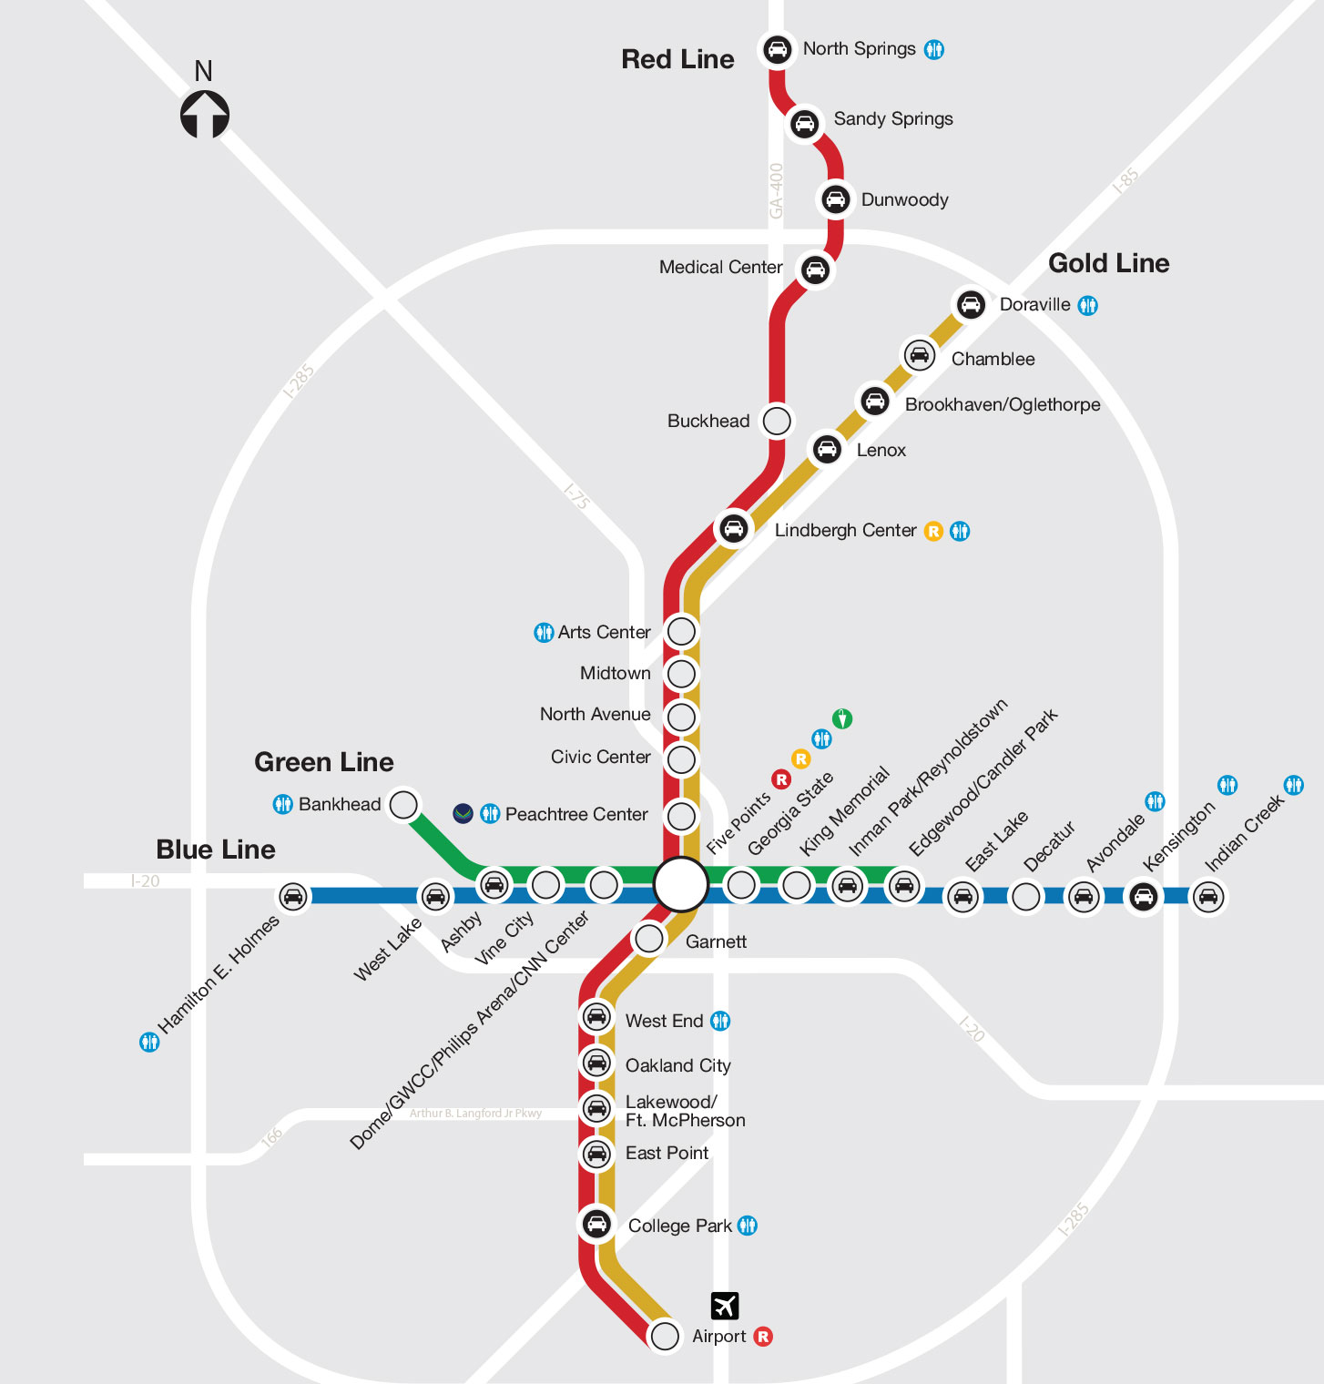

Current Situation
Motivation
Consider a notional trip between Hartsfield-Jackson Int’l Airport three areas in Atlanta: Midtown, Buckhead, and Sandy Springs
Current Methods
Subway
Midtown | 23-33 (min)
Buckhead | 32-42 (min)
Sandy Springs | 41-51 (min)
Methodology
Implementation
Dashboard
Rideshare or Rental Car
Midtown | 22-45 (min)
Buckhead | 30-60 (min)
Sandy Springs | 40-75 (min)
Conclusions
Alex Ostrow
Notes:
Travel times within city limits are significantly longer than desired. Whereas it might have taken an hour to fly 600 miles to get into the city, it would take that same hour to travel the last 12 miles to the final destination. As such, there is clearly an issue with the given infrastructure.

Slide 5
Motivation for Air Mobility
Motivation
Long time to travel short distances
Shortcomings in transportation system
Current Methods
Common problem to many urban areas
Inadequate or limited public transportation
Congested roadways
Methodology
Implementation
Significant project duration
Dashboard
Challenging to find solution to this given existing infrastructure
Significant capital investment
Significant disruption to existing infrastructure
Conclusions
A new method is needed for mobility in urban areas
Alex Ostrow
Notes:
These long times to travel short distances indicate shortcomings in the current transportation system, and are largely caused by limited public transportation or congested roadways. While improving the existing infrastructure is desirable, there are significant duration, investment, and disruption considerations that make it challenging. As such, a new method is needed for mobility in urban areas.

Slide 6
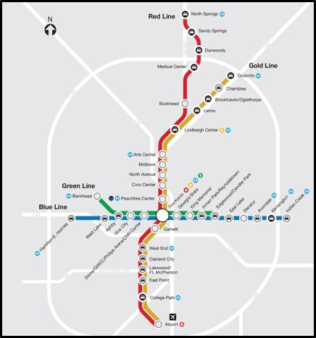
Motivation for Air Mobility
Motivation
What if a third dimension was added to routes?
Current Methods
Methodology
Implementation
Dashboard
Conclusions
Alex Ostrow
Notes:
What if we were to add the third dimension to routes? After all, we have been flying between cities for many years. This is where urban air mobility, or UAM, fits in to the transportation infrastructure.

Slide 7

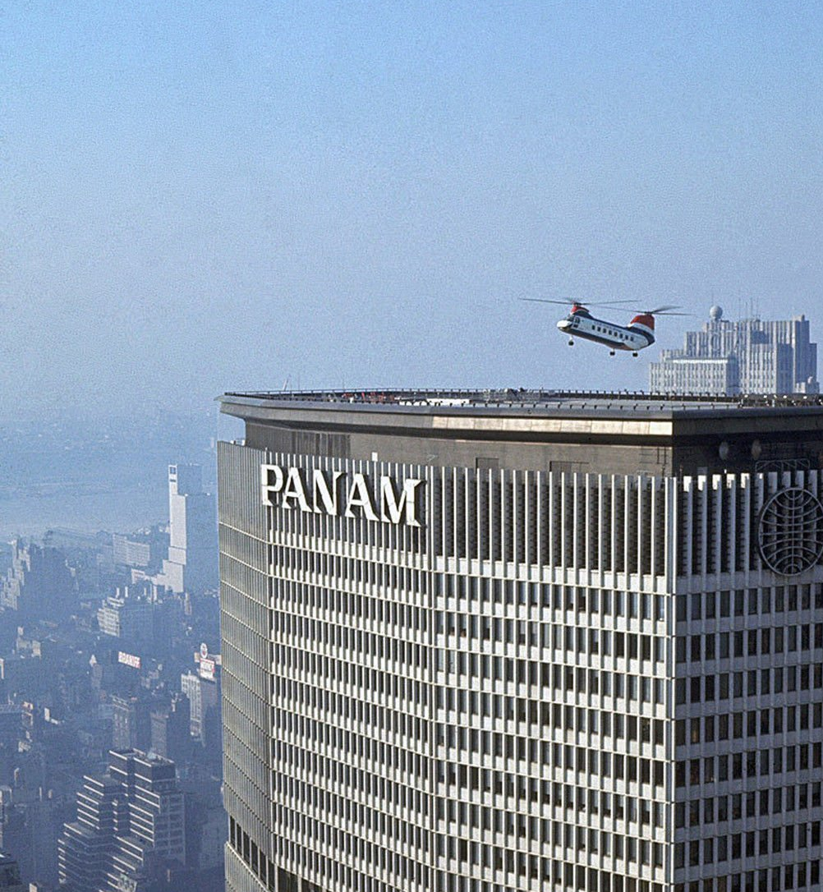

Past & Current Implementations
Motivation
Urban Air Mobility isn’t a fundamentally new idea
Current Methods
1965
Present Day
Methodology
Implementation
Dashboard
Conclusions
Flights from Manhattan
to surrounding airports for $43(adjusted)
Flights from lower Manhattan
to J.F.K. airport for $200-225
Alex Ostrow
Notes:
UAM isn’t a fundamentally new idea. As early as the 1960s, companies have been offering services using conventional helicopters as air taxis. These services still exist today, but generally serve a niche market in a small number of cities.

Slide 8
Past & Current Implementations
Motivation
These implementations are not the solution we are seeking
Current Methods
Affordability
Concerns
Noise
Concerns
Emission Concerns
Safety
Concerns
Methodology
Implementation
Increasing public resistance to proliferation of helicopter operations in urban areas
Dashboard
Legislation being proposed to limit urban helicopter activities
Improving Helicopter Safety Act (2019)
Conclusions
Need for a better solution and supporting infrastructure
Alex Ostrow
Notes:
Although conventional helicopters fulfil the UAM role, they are not the solution we are seeking due to affordability, noise, emission, and safety concerns. There is an increasing public resistance to helicopter operations, so much so that legislation is even being proposed to limit their activities. As such, a better solution and supporting infrastructure is needed.

Slide 9










Enablers for Urban Air Mobility
Motivation
Electric Propulsion
Sensor Technology
Current Methods
Methodology
Battery Technology
Autonomy
Implementation
Convergence of Enablers
Dashboard
Material Technology
Rapid Development Time
Conclusions
Comm. Networks
Alex Ostrow
Notes:
Many emerging technologies allow eVTOL UAM to be considered as a viable alternative, as shown above. Some, like battery technology and autonomy, are propelled by the automotive industry, while others are more aerospace-centric.

Slide 10
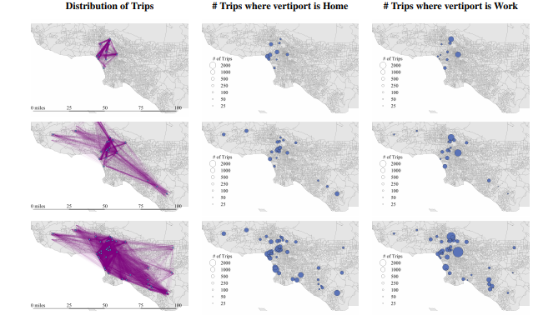
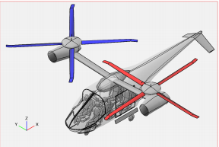
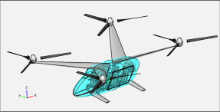

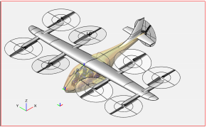

Previous Analyses
Motivation
Analysis has been done with configuration/CONOPS selected at start
Current Methods
Elements have been investigated such as:
Vertiport placement^{[8]}
Methodology
Vehicle performance & design elements^{[5][8]}
Implementation
Time savings^{[7]}
Dashboard
Environmental Factors^{[7]}
Conclusions
Want to expand upon these studies with
big-picture framework that evaluates and compares CONOPS
Alex Ostrow
Notes:
Of course this is not the first time UAM has been analyzed. However, much of the analysis has been done with CONOPS/configuration selected at the start, evaluating specific elements. As such, this years GC project seeked to build upon these studies with a big picture framework to evaluate and compare CONOPS.

Slide 11
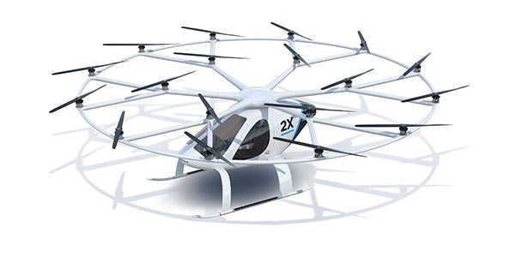

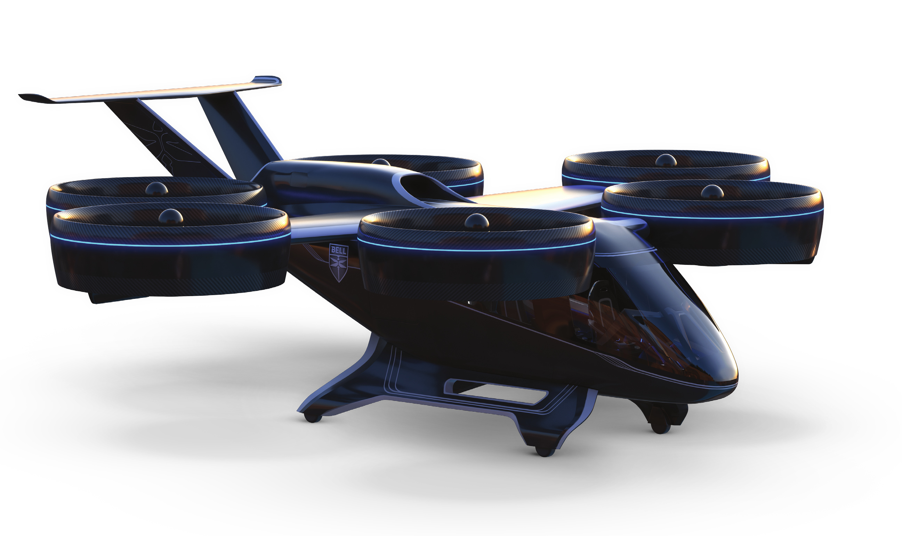
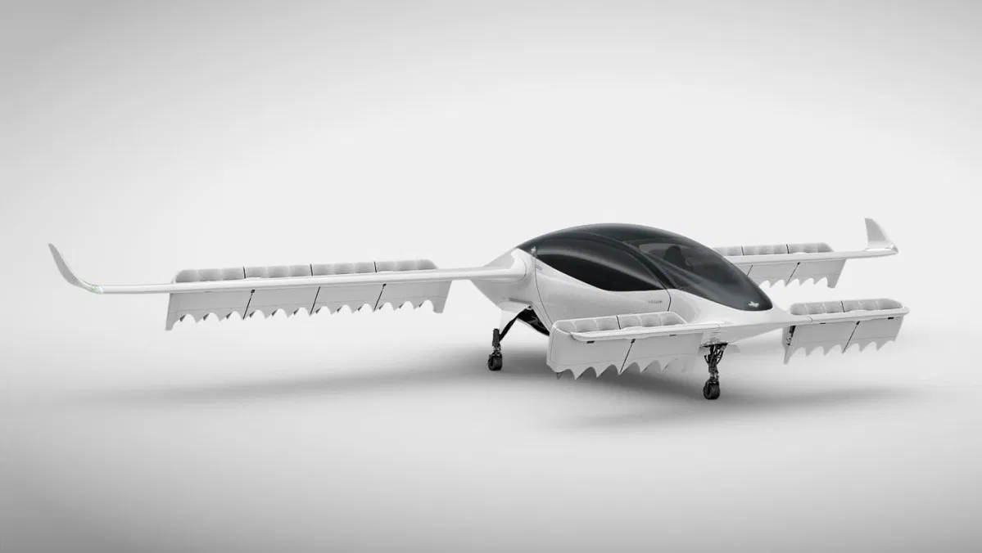
Emerging Concepts are Point-Designs
Motivation
Volocopter 2X
Functional
Physical
On-Demand
Current Methods
[12]
vs
BLADE
Methodology
Scheduled
Despite operating in the same emerging markets, physical and functional designs vary greatly between concepts
Implementation
[10]
Bell Nexus
Defined Routes
Dashboard
vs
[11]
Conclusions
Point-to-Point
Lilium Jet
[13]
Alex Ostrow
Notes:
Emerging designs differ both functionally and physically
Functional designs range from on demand services to scheduled services, flying defined routes or as true point-to-point air taxis
The vehicles themselves are very dissimilar as well, ranging from fully electric multirotors to hybrid electric tiltrotors

Slide 12
Challenges in Implementation
Motivation
Significant challenges associated with modelling and evaluating a SoS due to large number of variables involved
Current Methods
Methodology
How can we capture a UAM SoS architecture in a manageable way?
Implementation
Dashboard
How can we evaluate this architecture?
Conclusions
Alex Ostrow
Notes:
Given that there are a large number of variables involved, this years GC attempted to capture a UAM SOS in a manageable way and evaluate it.

Slide 13











How would a SoS be Scoped?
Motivation
What is the overall purpose of the System-of-Systems?
What are the functions of each element?
Current Methods
Who is going to use it, why will they use it, and how will they use it?
What are the constraints on each element?
Methodology
Implementation
What elements does the network consist of?
Where will the network be located, and what is its physical layout?
Dashboard
Conclusions
What does each element interface with (externally and internally)?
What technologies (future or present) will be leveraged to support the system?
Alex Ostrow
Notes:
Scoping a general SOS problem would begin by providing the following context:
Overall purpose
Stakeholders
Elements (including interfaces, functions, and constraints)
Location and Layout
Technologies leveraged

Slide 14





Context Required to Scope UAM SoS
Motivation
- Level of Autonomy
- Maintenance, Repair, & Overhaul
- Pilot Training (If Piloted)
- Noise Output
- Fleet Operations Management
- Vehicle Safety
- Airworthiness Standards
- Certification Processes
- Public Acceptance
- Implementation Roadmap
Current Methods
Vehicle
Regulations
Methodology
Implementation
- Airport/Vertiport Infrastructure
- Charging Stations
- Urban Planning/Zoning
- Policy Development
- Ownership (Public/Private)
- Unmanned Traffic Management
- Communications & Navigation
- Flight Procedures
- Data Exchange and Coordination
- Cybersecurity
Dashboard
- Consumer Demand
- Passenger/Cargo Operations
- Affordable Transportation
- On-Demand vs Scheduled
Airspace
Infrastructure
Conclusions
Economics
[9] Briceno, Simon. Urban Air Mobility: What is it and how soon? Georgia Airports Association Annual Conference and Exposition, September 2019
Alex Ostrow
Notes:
More context is required to scope a UAM SOS problem, falling into 5 key categories:
Vehicle
Infrastructure
Airspace
Regulations
Economics

Slide 15
Research Question
Motivation
Given that the design space for a UAM SoS is unmanageably large, how can we support decision-making and evaluation?
Current Methods
Methodology
The methodology must satisfy the following:
Implementation
Flexible to allow assessment of different SoS
Dashboard
Parametric environment to allow user adjustment
Conclusions
High level outputs allowing for comparisons
Alex Ostrow
Notes:
Research question attempts to intelligently restrict the design space so decision making and evaluation can be done for a UAM SOS

Slide 16
Methodology Introduction
Motivation
Importance of defining a methodology beforehand
Current Methods
Interested in a modelling & simulation approach
Need defined methodology for results to be meaningful and reproducible
Methodology
Implementation
Dashboard
Evaluating a UAM SoS is inherently reliant on data and mathematical relationships, but need a way to ensure credible results
Methodology developed in UAM context, but for use across general SoS problems
Conclusions
Alex Ostrow
Notes:
Methodology must be defined early on in order for results to be meaningful and reproducable
Methodology developed in UAM context, but for use across general SOS problems (not constrained to UAM)

Slide 17
Methodology Roadmap
Motivation
1
2
3
Selecting a Perspective
Understand and Scope System of System Goals
Develop / Identify Evaluation Criteria
Current Methods
Methodology
Implementation
4
5
6
Decompose Evaluation Criteria
Create Simulation Environment
Generate and Analyze Results
Dashboard
Conclusions
Iterate Until Desired Fidelity Achieved
Alex Ostrow
Notes:
Iterative process, illustrated in further detail

Slide 18
Selecting a Stakeholder Perspective
Motivation
Different stakeholders have different needs and standards by which they evaluate a SoS
Current Methods
Need to define stakeholder perspective at beginning to determine evaluation criteria
Methodology
Example Stakeholders and Associated Criteria for a UAM SoS
Implementation
Operators
Operating Costs
Dashboard
Manufacturers
Demand
Customers
Time Savings
Conclusions
City Planners
Environmental Impact
Regulators
Safety
Alex Ostrow
Notes:
Different stakeholders will evaluate a SOS differently, so is important to select one early
This drives the SOS goals chosen and evaluation criteria

Slide 19


SoS Goals and Evaluation Criteria
Motivation
SoS alternatives can take the form of dissimilar architectures
Current Methods
Surveillance
Example
vs
Methodology
Implementation
Need to identify SoS goals that are independent of a specific implementation
Dashboard
Criteria #1
Criteria #2
Criteria #3
Criteria #4
Conclusions
Map each goal to one or more evaluation criteria
(Specific, measurable quantities)
Alex Ostrow
Notes:
SOS alternatives can be very different, but achieve the same goal
Therefore the goal must be identified independent of a specific implementation, and mapped to evaluation criteria

Slide 20
Breakdown of Evaluation Criteria
Motivation
Current Methods
High level SoS goals
Evaluation Criteria
Breakdown
SoS Variables
Methodology
Breakdown is a highly nontrivial exercise
Implementation
Need for a structured and systematic approach to the breakdown
How can you link the SoS variables to the high-level goals?
Dashboard
What level of a breakdown is required?
Conclusions
How many variables should be retained in the breakdown?
Alex Ostrow
Notes:
Evaluation criteria are broken down to make up the SOS variable set, or the design variables that describe the SOS
This breakdown exercise must be done in a systematic and structured way to retain only the appropriate variable set

Slide 21
Simulation Environment
Motivation
Link resulting breakdown in simulation environment
Current Methods
SoS Design Variable #1
SoS Design Variable #2
…
SoS Design Variable #n
Methodology
Implementation
Dashboard
Conclusions
Evaluation Criteria #1
Evaluation Criteria #2
…
Evaluation Criteria #m
Alex Ostrow
Notes:
After the evaluation criteria are broken down into variables and functions, they can be linked in a simulation environment

Slide 22
Analysis & Iterations
Motivation
Design of Experiments
Insensitive Response, No Need For Additional Modeling Capability
Current Methods
R₂
Methodology
x_{j}
Implementation
Highly Sensitive, Candidate for More Detailed Model
Develop More Detailed Model
R₁
Dashboard
x_{i}
Integrate Updated Model into Simulation Environment
Conclusions
Assumption that models capture true behavior of SoS
Alex Ostrow
Notes:
In order to evaluate whether a model requires further fidelity, an initial design of experiments is performed over the entire design space
Examining trends, and sensitivities
If a response is highly sensitive to a simplistic model, it is a likely candidate for a further detailed model

Slide 23
Intended Use
Motivation
Simulation environment is a decision-making tool after development
Current Methods
Use simulation environment to make initial decisions
Fix chosen configuration as baseline and explore design space
Create surrogates and make final design adjustments
Methodology
Implementation
Dashboard
Conclusions
Alex Ostrow
Notes:
Overall intended use of the methodology is to produce a decision-making tool to select between CONOPS

Slide 24

Perspective Selected for Implementation
Motivation
Subsequent steps in the methodology are informed by contextual information
Current Methods
Who is using the methodology?
City council decision-maker
Methodology
Responsible for evaluating which UAM SoS to implement, if any, for an airport shuttle use case
Different objectives
Different relevant metrics
Implementation
Dashboard
Benefits vs. Costs Assessment
Who is benefitting ?
What is the societal impact?
Conclusions
Who will be adversely impacted?
What are the benefits?
Victor Petitgenet
Notes:
Selected point of view of a city council decision maker for implementation
Imagining city this decision maker is going to be making a series of cost vs benefit assessments regarding implementing this SoS

Slide 25
Identification of SoS Goals
Motivation
Understand SoS architecture to facilitate evaluation criteria identification
DoDAF & FAA EA
Current Methods
Enables the development of complex architectures and facilitates decision making through information sharing
OV-1
OV-2
Creation of a series of static views
Methodology
OV-3
Implementation
ARCHITECT Process
GQM Approach
Enables the understanding of the impact of architecture-level decisions, focus on executable products
Goals
Dashboard
Retained GQM from ARCHITECT to guide subsequent breakdown exercise
Questions
Conclusions
Metrics
Data
Data
Victor Petitgenet
Notes:
Explored DODAF and FAA EA to better understand SoS
Not very useful since they’re focused on static products
Interested in the ARCHITECT process where there is a focus on an executable product

Slide 26



Identifying Evaluation Criteria
Motivation
UAM provides an alternate transportation solution to decrease travel time at an acceptable cost while minimizing adverse societal impact
Current Methods
Methodology
Time Savings
Implementation
Affordability
Goals
Dashboard
Societal Impact
Conclusions
Victor Petitgenet
Notes:
Returning to the original motivation statement for UAM
From this statement, there are three goals that can be translated to evaluation criteria

Slide 27
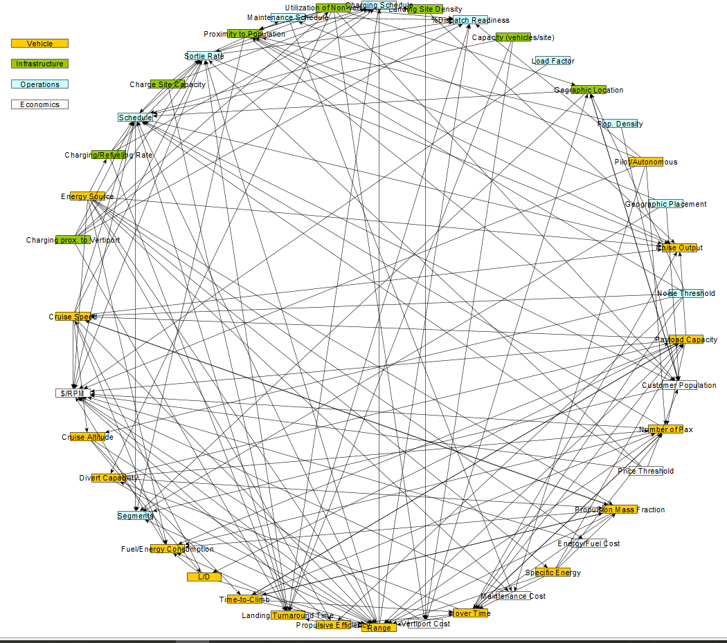



Breakdown: “Bottom-Up” Approach
Motivation
Approach Steps
Current Methods
Discern categories
List elements
Interlink elements
Link elements to eval. criteria
Methodology
Implementation
Dashboard
Economics
Infrastructure
Conclusions
Inadequate Method
Operations
Vehicle
Victor Petitgenet
Notes:
Explored a top down approach to decompose the evaluation criteria into the SoS variables
Step to this approach shown
Ultimately deemed this approach to be inadequate

Slide 28
Breakdown: “Top-Down” Approach
Motivation
“Top-Down” Approach
Downsides of ”Bottom-Up”
Identify specific evaluation criteria
Assign mathematical relationships to evaluation criteria
Current Methods
Different types of elements
Different levels of elements
Vague element definitions
Unclear links between elements
Methodology
Implementation
Decompose variables (as required)
Identify relevant variables
Dashboard
“Top-Down” Approach
Conclusions
Link variables
Victor Petitgenet
Notes:
Reasons for deeming the bottom-up approach to be inadequate shown
Thus, switch to using a top-down approach
Steps to top-down approach shown

Slide 29
Evaluation Criteria Definitions
Motivation
Population Cumulative Time Savings
Required Average Yield per Revenue Pax Mile
Overall Societal Impact
Current Methods
Total amount of time saved by users of UAM network
Assesses overall effectiveness of a UAM network
Comparison with existing methods of transportation
Amount an operator must charge paying passengers to break even
Assesses affordability, especially from customer perspective
Total population exposed to at least a given noise level
Assesses societal acceptability of a UAM network
Methodology
Implementation
Dashboard
Conclusions
Units are hours
Units are cents/pax/mile
Units are # people
Victor Petitgenet
Notes:
Selected three shown evaluation criteria for the remainder of this implementation

Slide 30




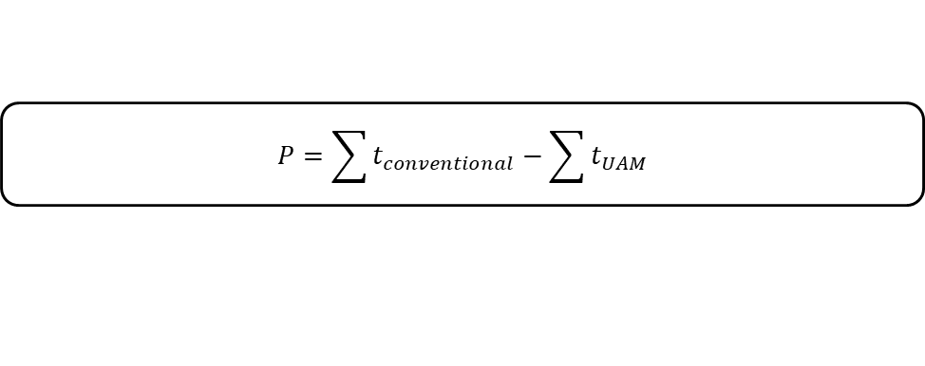
Cost & Time Savings
Motivation
Cost
$$\$/{RPM}=\frac{Total Operating Cost}{\#Seats∗Load Factor∗Distance}$$
Current Methods
Methodology
Time Savings
$$P=\sum{t_{conventional}}−\sum{t_{UAM}}$$
Implementation
$$t_{UAM}=\frac{Average Route Distance}{Average UAM Speed}$$
Dashboard
Average Route Distance $f(…)$
Average UAM Speed $f(…)$
Conclusions
Region of Operation
Origin
Destination
Vehicle Characteristics
Mission Profile
Victor Petitgenet
Notes:
Example of the mathematical relationships associated to each of the evaluation criteria
As seen, these can begin to be notionally decomposed

Slide 31
Evaluation Criteria: Societal Impact
Motivation
Noise is a key concern for the implementation of a UAM network
No single, direct measure of societal impact
Noise
Current Methods
Emissions
Methodology
Visual Pollution
Rotational Noise
Implementation
Vehicle Weight | Number of Rotors | Number of Blades
Rotor Torque | Tip Mach Number | Rotor Solidity
Rotor Angular Velocity | Thrust Loading | Rotor Thick. to Chord
Route Characteristics
Distance to observer
Dashboard
Mission Profile
Conclusions
Victor Petitgenet
Notes:
Societal impact is a more nuanced evaluation criteria to measure, many different possible meanings
Focusing on noise, specifically rotational noise for this implementation
Showing notional breakdown of noise

Slide 32
How much information is needed?
Motivation
Model could range from “back-of-the-envelope”
to full physics-based system model
Current Methods
What is the necessary level of information fidelity?
Methodology
Necessary to decompose each evaluation
criterion to an appropriately low level
Implementation
“Appropriately low level” means different things to different people; SME might only need a few specific values to determine if a system is viable, while others might need to define entire system before assessment can be made
Dashboard
Conclusions
Need to be able to navigate through various levels of
information fidelity and still be able to get meaningful results
Victor Petitgenet
Notes:
Leads to the question of how much information is needed
What is the necessary level of information fidelity ?
Different answers depending on the selected perspective

Slide 33
SoS Decomposition Levels
Motivation
Example Measurable Quantities
Current Methods
Evaluation Criteria
Network
Methodology
Decreasing Complexity
Specific Implementation
Mission Ranges
Passenger Demand
Total Operating Cost
Implementation
Increasing Specificity
Dashboard
Engineering / Physics
Rotor Material
Communication Protocol
Airframe Component Weights
Conclusions
Victor Petitgenet
Notes:
Showing example of possible decomposition levels
Network is the highest level
Specific implementation contains high level variables
Engineering/Physics contains the lowest level, most granular variables

Slide 34
Environment Creation
Motivation
Need modules allowing for calculation of Evaluation Criteria that are interlinked
Current Methods
Inputs
Methodology
Time Savings
Cost
Societal Impact
Implementation
Proprietary Time Savings Module
Proprietary Cost Module
Proprietary Societal Impact Module
X %
Dashboard
X %
Research and Calibration Data
Static Implementation
Sensitivity
Analysis
X %
Conclusions
X %
X %
Environment
X %
SoS Sensitivities
Victor Petitgenet
Notes:
Need to develop modules that allow for the calculation of the evaluation criteria
Connect these modules to form an environment
Methodology is flexible to the user plugging in their own modules
Initially a static implementation but want to transition to being able to perform sensitivity studies

Slide 35
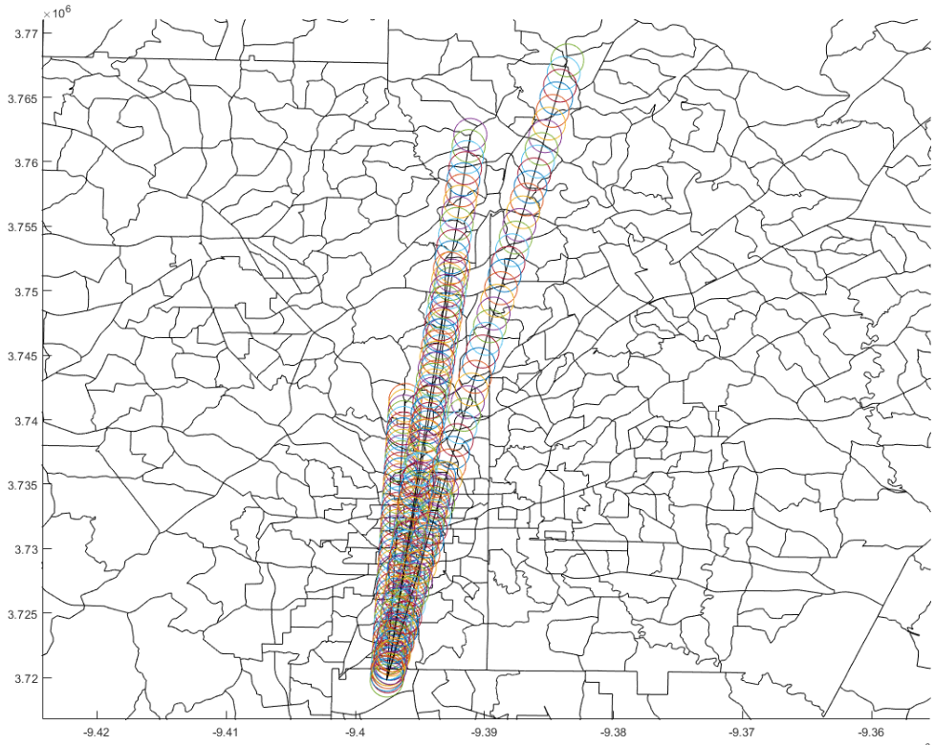
DoE Setup
Motivation
Use the environment to conduct a DoE around a fixed vertiport layout
Current Methods
Using bounds of ±25% around baseline value in most cases
Parameter | Low | High
SPL Threshold | 52 | 85
Vehicle Cruise Speed | 100 | 200
Vehicle Mass | 900 | 1500
Landing Fees | 37.5 | 62.5
… | … | …
Methodology
Implementation
Dashboard
Conclusions
Victor Petitgenet
Notes:
Set up a DOE around a fixed vertiport layout
±25% for most variables

Slide 36
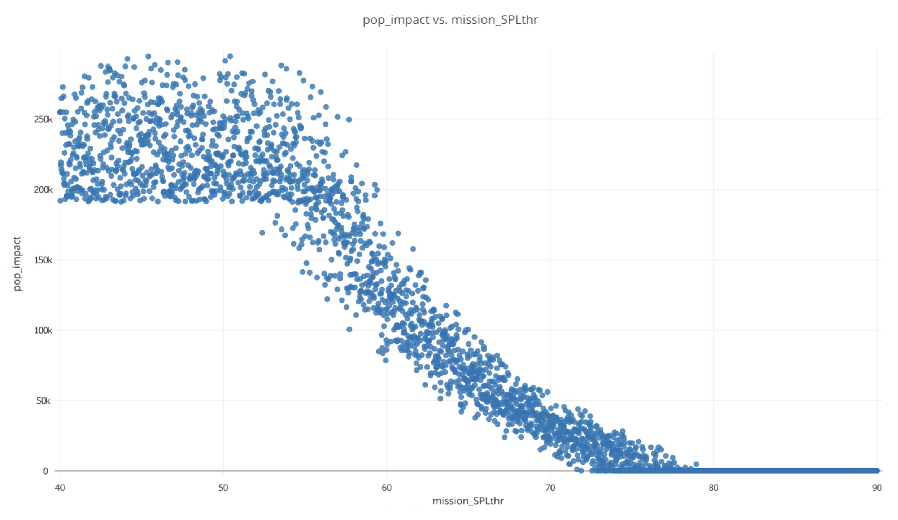
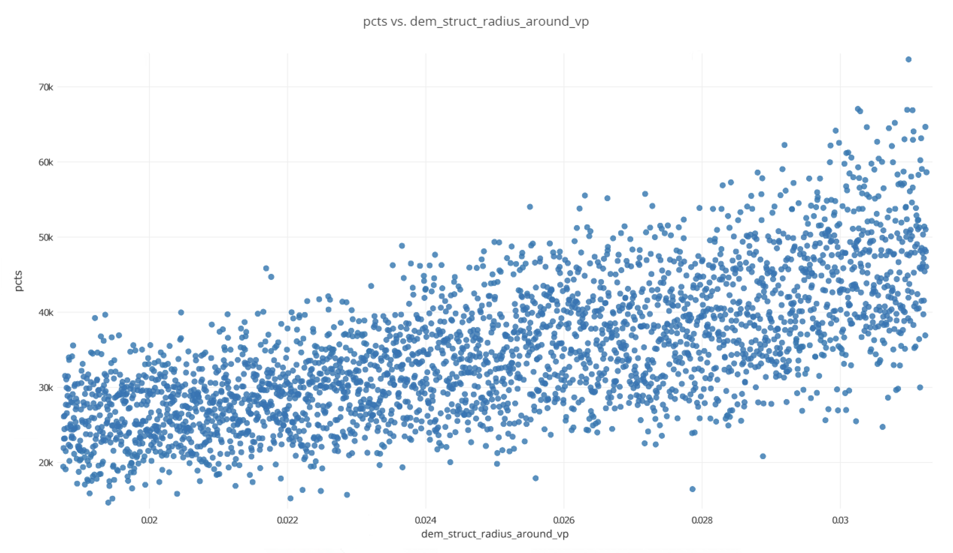
Environment Verification
Motivation
Presence of certain trends indicates models are working as expected
Current Methods
Population Impacted vs.
Sound Pressure Level Threshold
PCTS vs. Vertiport Radius
Methodology
Implementation
Population Impacted
PCTS
Dashboard
Conclusions
Sound Pressure Level Threshold
Vertiport Radius
Focus is on verifying trends, not specific values
Victor Petitgenet
Notes:
From DoE, were able to obtain results that showed that the models were working as expected

Slide 37
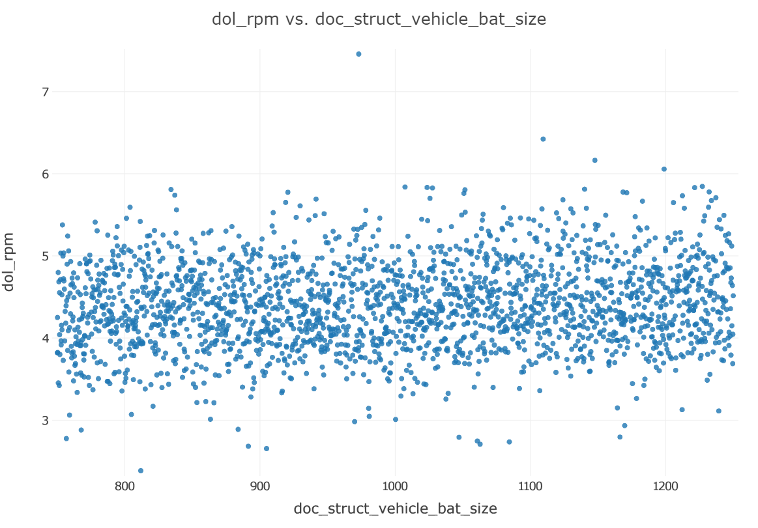

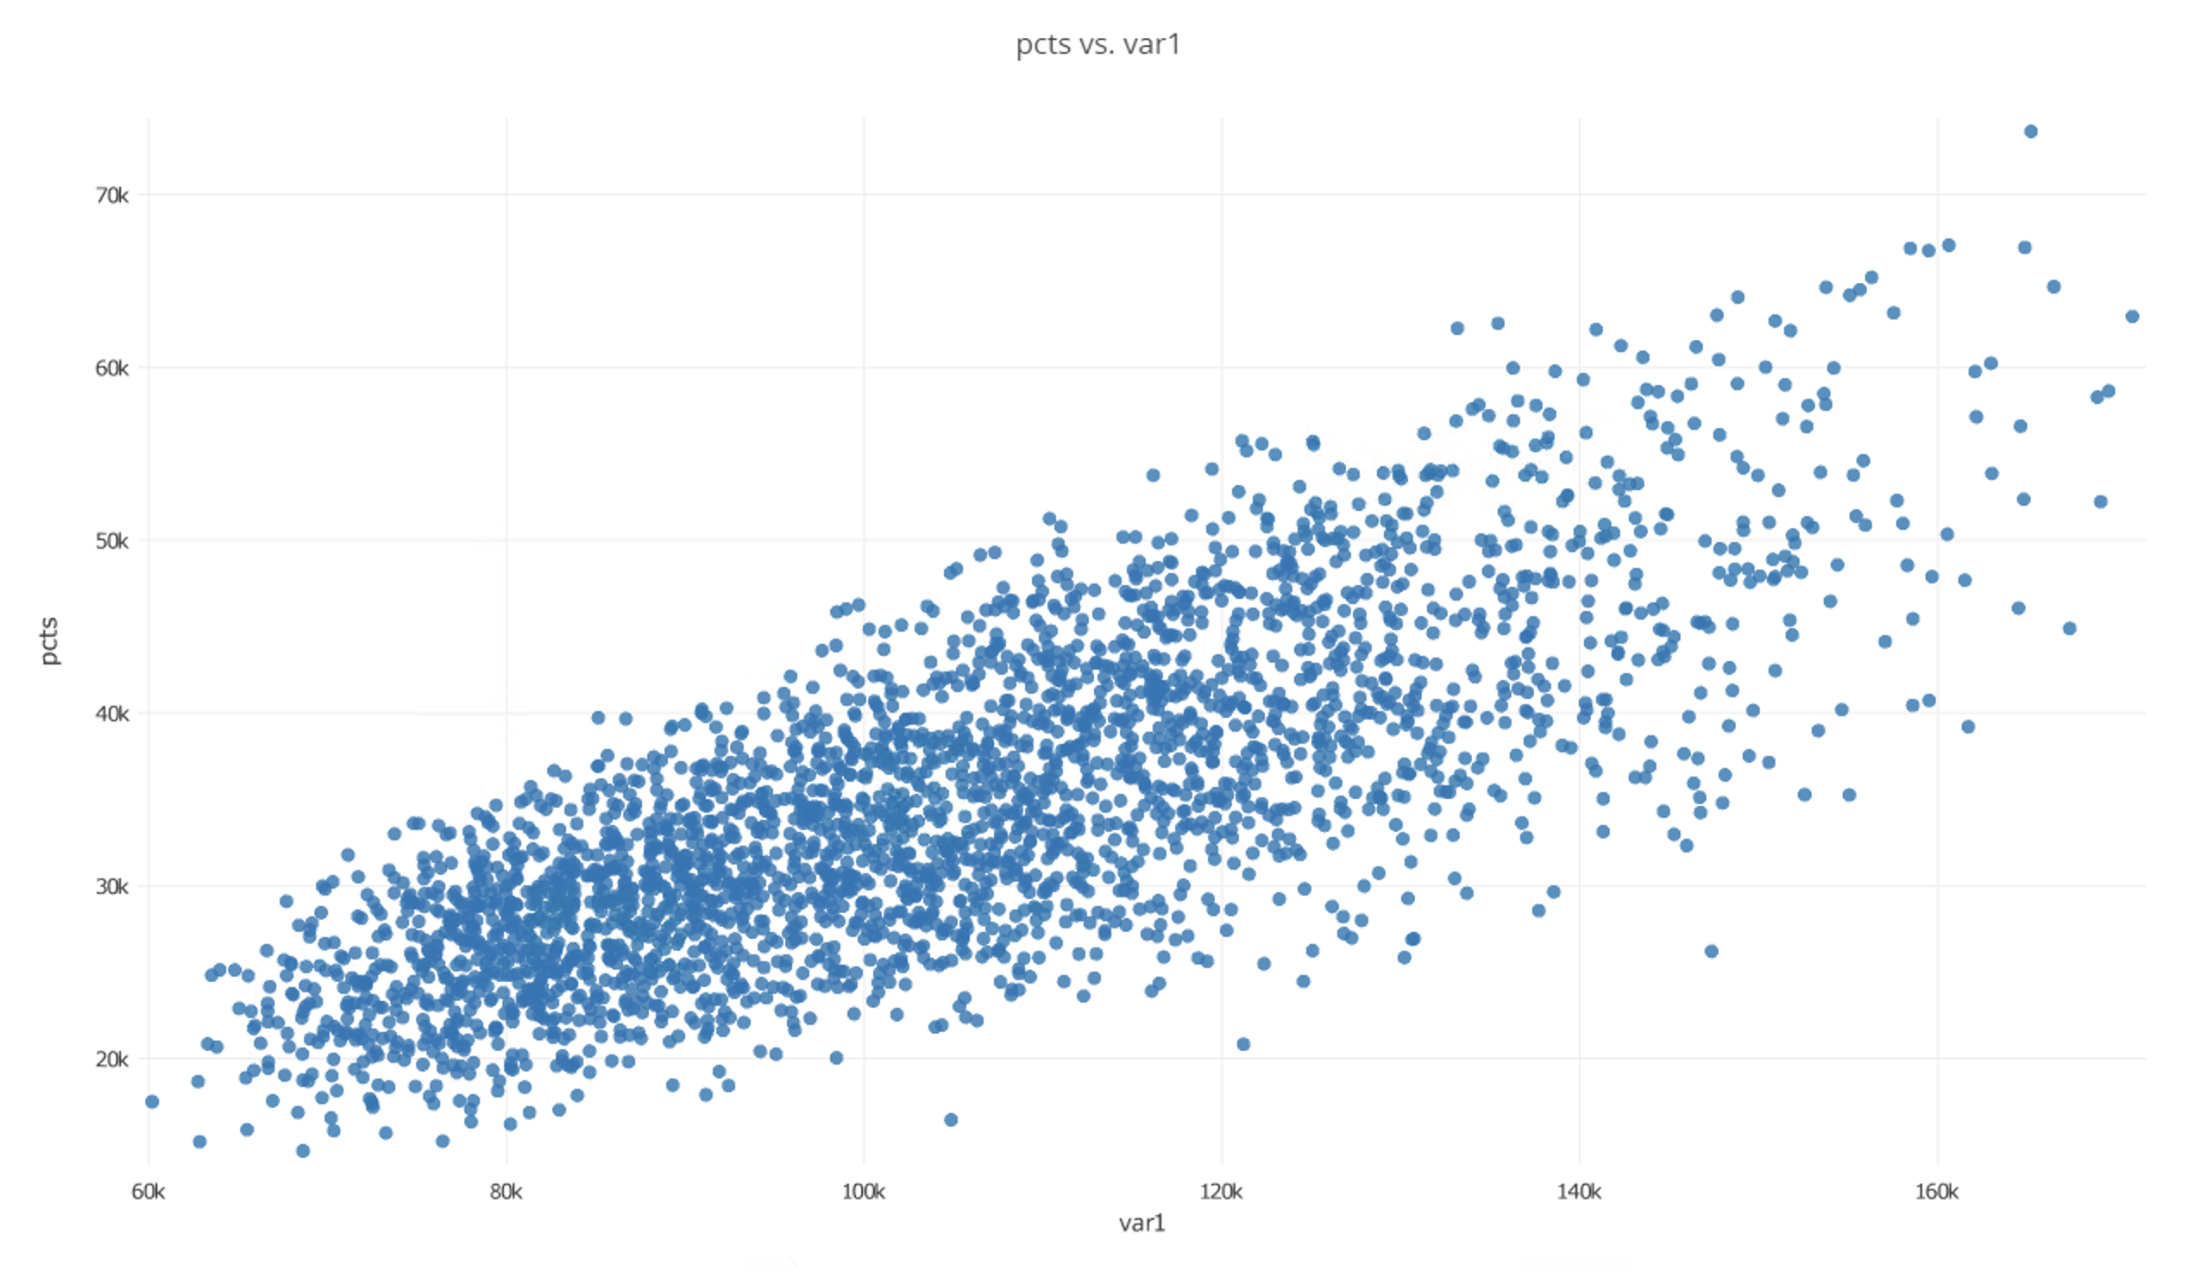
Response Sensitivities
Motivation
High Sensitivity:
Candidate for refined modelling
Current Methods
Is refining this model feasible?
R₂
Design of Experiments
$/RPM
Methodology
Is refining this model worthwhile?
x_{j}
Implementation
Battery Size
Dashboard
R₁
PCTS
Conclusions
x_{i}
Demand
Victor Petitgenet

Slide 38
Modeling Time-Dependent Demand
Motivation
Current Methods
Demand over Time-of-Day
Travel Time over Time-of-Day
Methodology
Xx:##
X
Xx:##
Demand
Travel Time
Travel Time
Implementation
Yy:##
Y
Zz:##
Z
Time of Day
Time of Day
Dashboard
Zz:##
ATL Departures for ~1 week binned into 1-hour slots
Curve shifted -2 hours to yield VP departure times
Default travel time modeled as additional time for rush hour, less time normally
Conclusions
Victor Petitgenet
Notes:
Switching from a constant demand throughout the day to a time dependent demand, using departure data from Atlanta airport
Also model increase in travel time due to rush hour

Slide 39
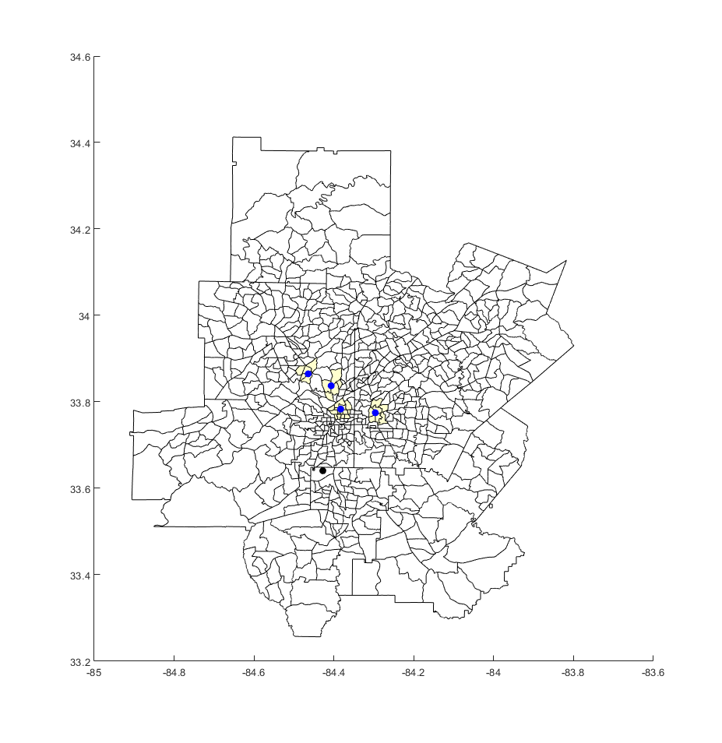
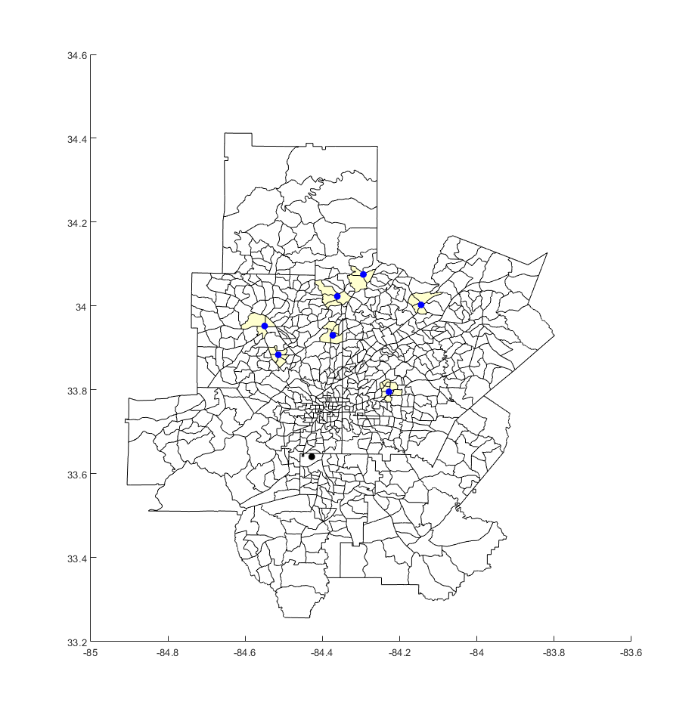
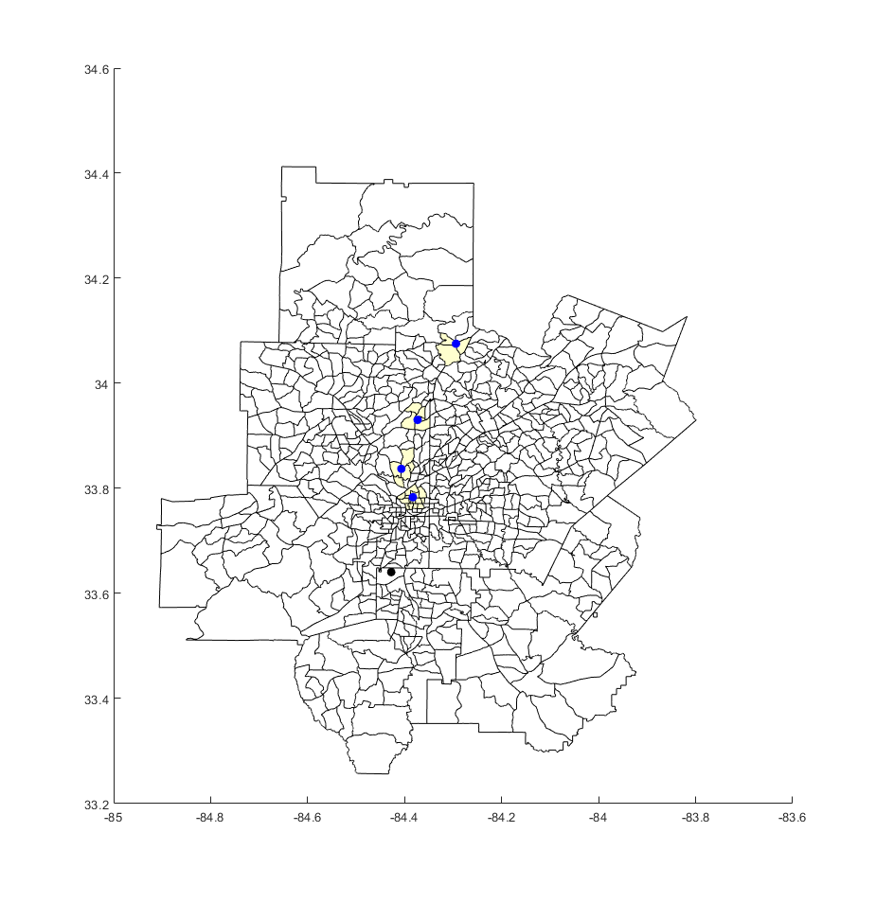

Generating Network Alternatives
Motivation
After environment was completed, network alternatives were generated from combining vertiport layouts and vehicle types
Current Methods
“Inside the Perimeter”
“Outside The Perimeter”
VP Locations
Marietta
Smyrna
Sandy Springs
Roswell
Alpharetta
Duluth
Dekalb
VP Locations
Midtown
Buckhead
Decatur
Vinings
Methodology
Implementation
“Targeted Demand”
“Close/Far Mix”
Dashboard
VP Locations
Midtown
Decatur
Marietta
Roswell
Alpharetta
Duluth
Dekalb
VP Locations
Midtown
Buckhead
Sandy Springs
Alpharetta
Conclusions
Victor Petitgenet
Notes:
Generated a series of 4 vertiport layout alternatives

Slide 40
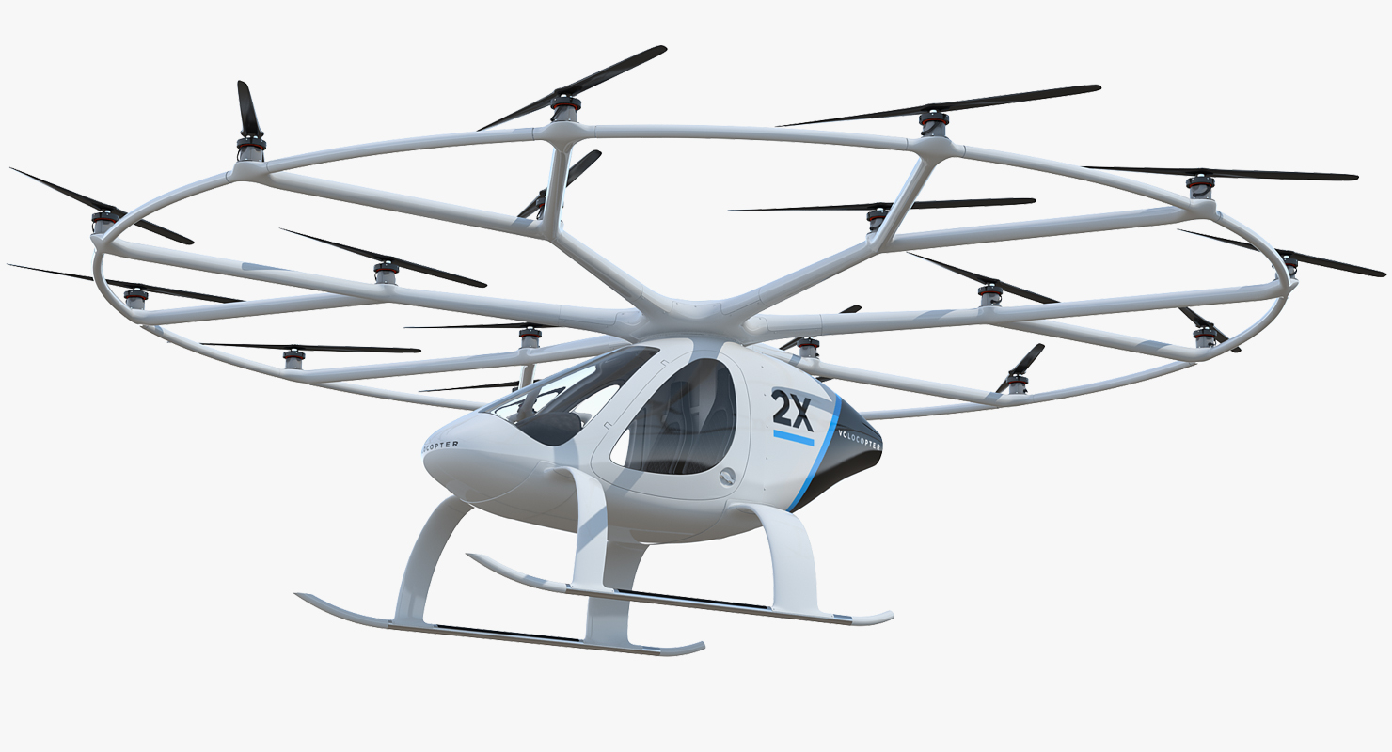
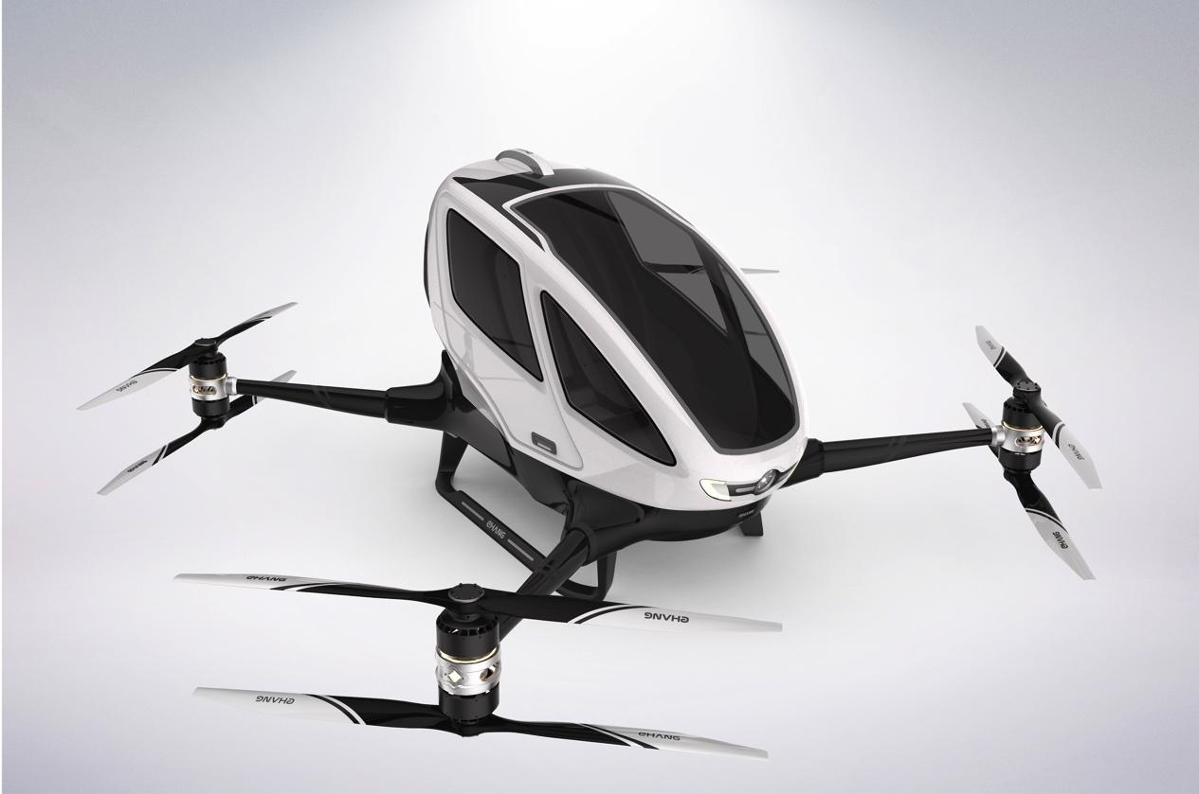
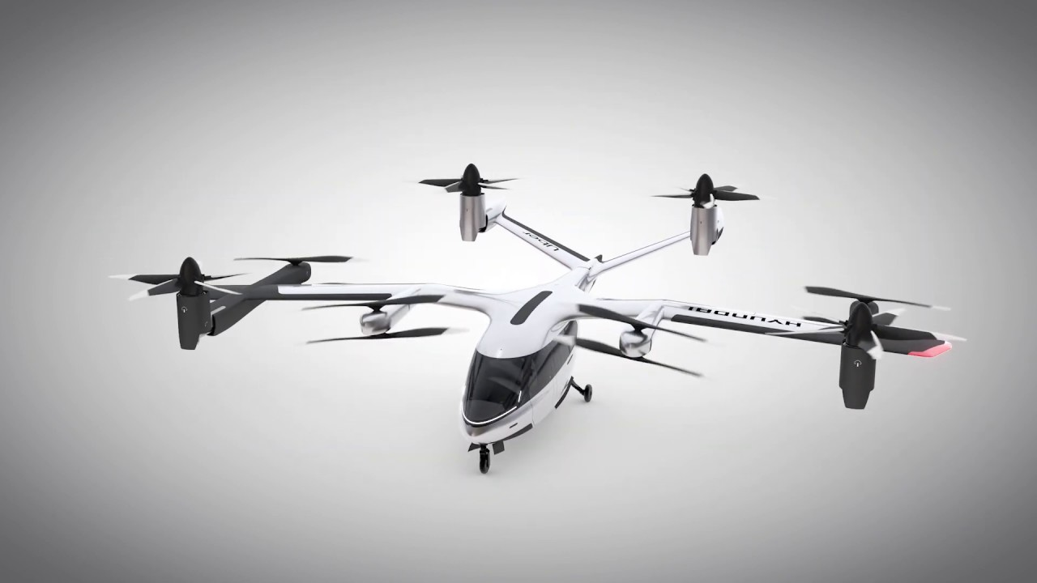
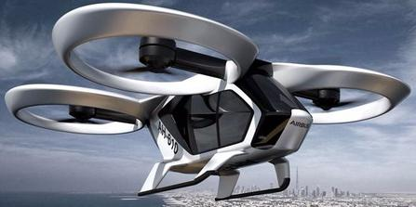
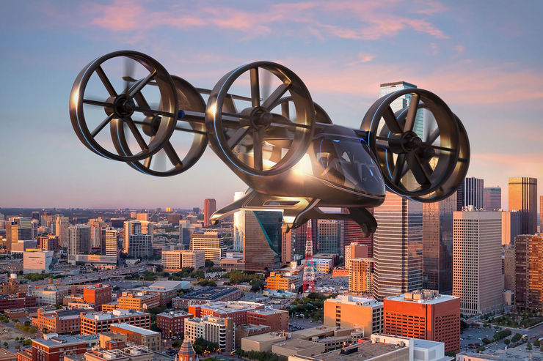
Generating Network Alternatives
Motivation
Vehicle types approximately resemble existing designs
Current Methods
“Light” Vehicle
“Medium” Vehicle
“Heavy” Vehicle
Methodology
Implementation
Design Variable | Value (autonomous)
Cruise Speed | 60 kts
Pax Capacity | 1 (2)
Number of Rotors | 24
Total Mass | 800 kg
Cost/Vehicle | $500,000 ($1,000,000)
Design Variable | Value (autonomous)
Cruise Speed | 100 kts
Pax Capacity | 3 (4)
Number of Rotors | 12
Total Mass | 1000 kg
Cost/Vehicle | $1,000,000 ($1,500,000)
Design Variable | Value (autonomous)
Cruise Speed | 150 kts
Pax Capacity | 5 (6)
Number of Rotors | 6
Total Mass | 1200 kg
Cost/Vehicle | $2,000,000 ($2,500,000)
Dashboard
Conclusions
Victor Petitgenet
Notes:
Generated a series of 6 total vehicle alternatives, loosely based on existing designs

Slide 41
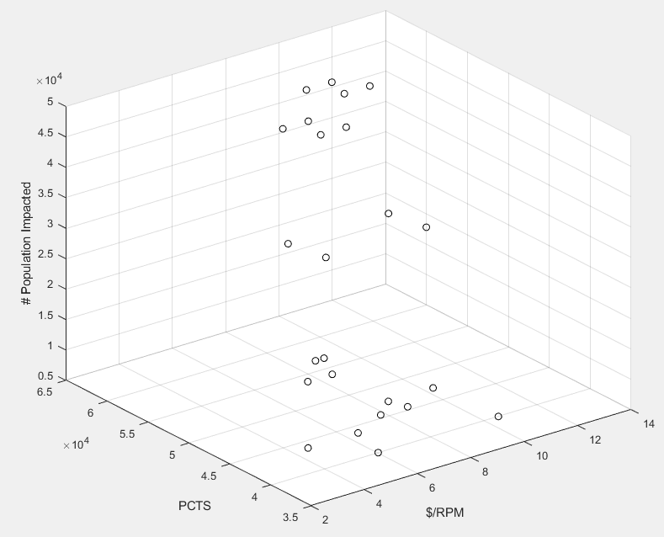
Analyzing Network Alternatives
Motivation
 | Light Piloted Vehicle | Light Auto Vehicle | Medium Piloted Vehicle | Medium Auto Vehicle | Heavy Piloted Vehicle | Heavy Auto Vehicle
ITP Config | X | X | X | X | X | X
OTP Config | X | X | X | X | X | X
Target. Demand Config | X | X | X | X | X | X
Close/Far Mix Config | X | X | X | X | X | X
Current Methods
Methodology
Population Impacted
Implementation
Dashboard
PCTS
24 Unique Configurations
$RPM
Conclusions
Evaluation criteria for each UAM network calculated using environment
Victor Petitgenet
Notes:
Total of 24 alternatives that were run through the environment in order to obtain the calculations for the evaluation criteria

Slide 42
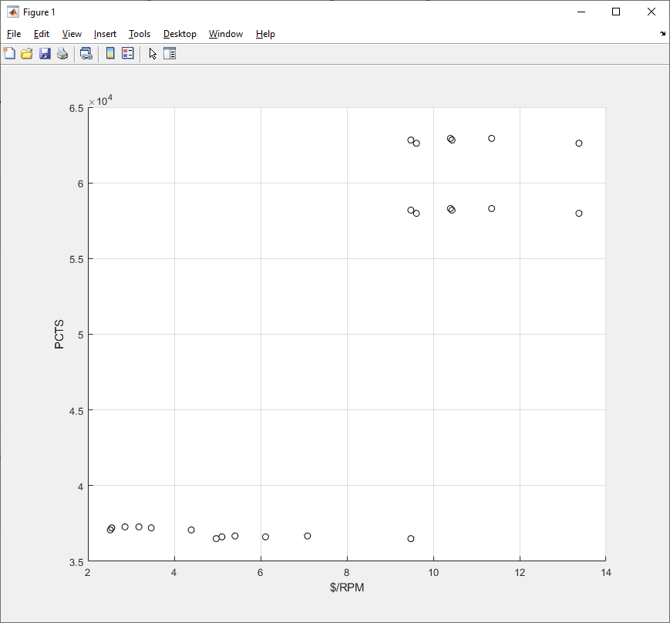
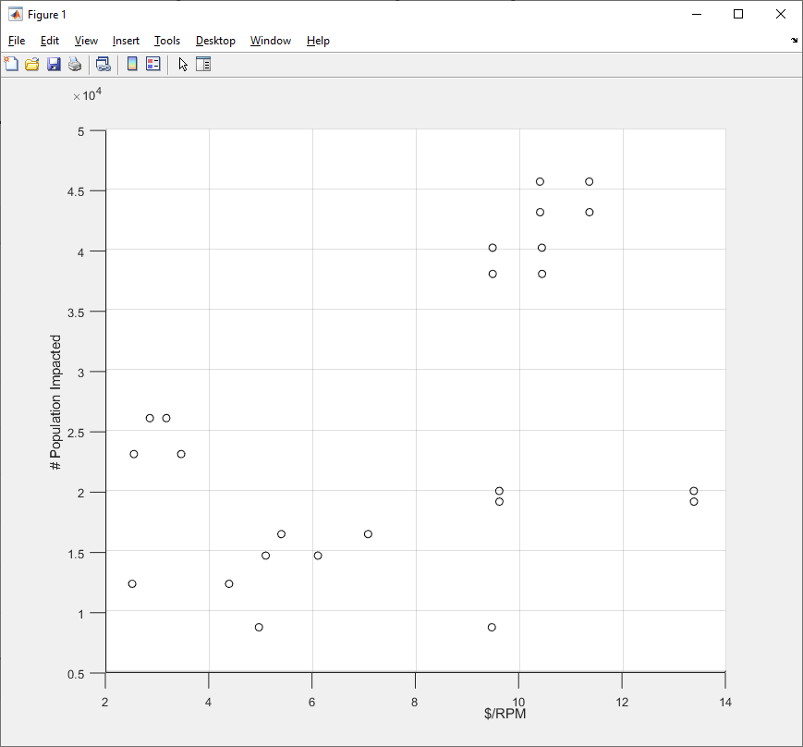
Analyzing Network Alternatives
Motivation
Current Methods
Methodology
Increasing vehicle size
“OTP” and “Close/Far Mix”, Med/Heavy Vehicle
Farther routes, noisier vehicle
Population Cumulative Time Savings
“Outside The Perimeter (OTP)” and “Close/Far Mix”
Less demand, significant time savings per flight
Population Impacted
Implementation
“Inside The Perimeter (ITP)” and “Targeted Demand”
More demand, less time savings per flight
Dashboard
Increasing vehicle size
Conclusions
$/RPM
$/RPM
Victor Petitgenet
Notes:
From the resulting 24 configurations some general trends were discovered, most notably depending on whether the operation is inside the perimeter or outside the perimeter significantly impacts the PCTS. $/RPM tends to decrease as vehicle size increases due to the dispersion of operating cost across more passengers. A larger vehicle is also correlated with a higher population effected.

Slide 43
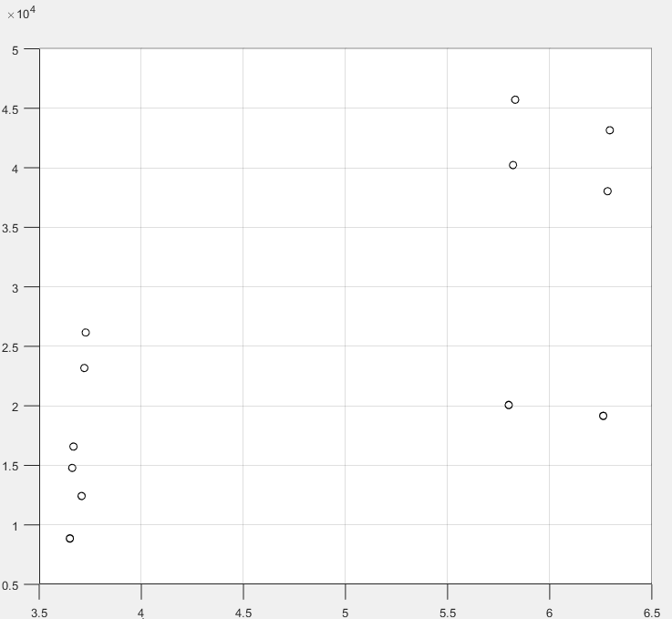
Analyzing Network Alternatives
Motivation
Key Takeaways
Current Methods
“OTP” and “Close/Far Mix”, Med/Heavy Vehicle
Farther routes, noisier vehicle
“Medium” Vehicle captures the same benefits of “Heavy” Vehicle at lower $/RPM
“Light” Vehicle in a high-demand, long range routes cannot sustain demand
Impact of autonomy is less obvious as vehicle capacity increases
Methodology
“ITP” and “Targeted Demand”
Shorter routes, less area covered
Population Impacted
Increasing vehicle size
Implementation
Increasing vehicle size
Dashboard
“OTP” and “Close/Far Mix”, Light Vehicle
Farther routes, less noisy vehicle
Conclusions
Population Cumulative Time Savings
Victor Petitgenet
Notes:
Echoing the aforementioned trends, PCTS is significantly effected by the OTP routes as there is a much larger time savings per trip but at a lower demand level.

Slide 44
Refined Selection
Motivation
Evaluation criteria used to select best alternative
Current Methods
Autonomous “Medium” Vehicle
Perform final DoE around selected alternative
±10% around all design variables
Methodology
“Close/Far Mix” Config.
Create surrogate models for evaluation criteria
Implementation
PCTS: 62830
(hours)
Explore sensitivity of Evaluation Criteria
Dashboard
$/RPM: 9.4795 ($/pax/mile)
May be necessary to create multiple sets of surrogate models depending on alternatives being compared
Conclusions
Pop. Imp: 37944 (people)
UAM Airport Shuttle
vs.
UAM Airport Shuttle
Single Set
UAM Airport Shuttle
vs.
UAM Air Taxi
Multiple Sets
Victor Petitgenet
Notes:
Selected the Autonomous ”med” vehicle as the most favorable alternative with the close/far vertiport config
Performed final DoE around this layout
Explaining necessary steps if we wanted to consider dissimilar CONOPS, comparing similar CONOPS for this implementation although methodology is flexible

Slide 45
Tying in the 5 Categories
Motivation
Capability to assess overall importance in addition to specific sensitivities
Current Methods
Determine the overall sensitivity of an evaluation criteria to a given area
Allow decision maker to focus their efforts on relevant areas
Methodology
Implementation
$/RPM
Pop. Cumulative Time Savings
Population Impacted
Dashboard
Conclusions
Victor Petitgenet
Notes:
Also want to be able to aggregate the sensitivities of the evaluation criteria to the 5 key areas of UAM
Showing results from aggregating sensitivities

Slide 46
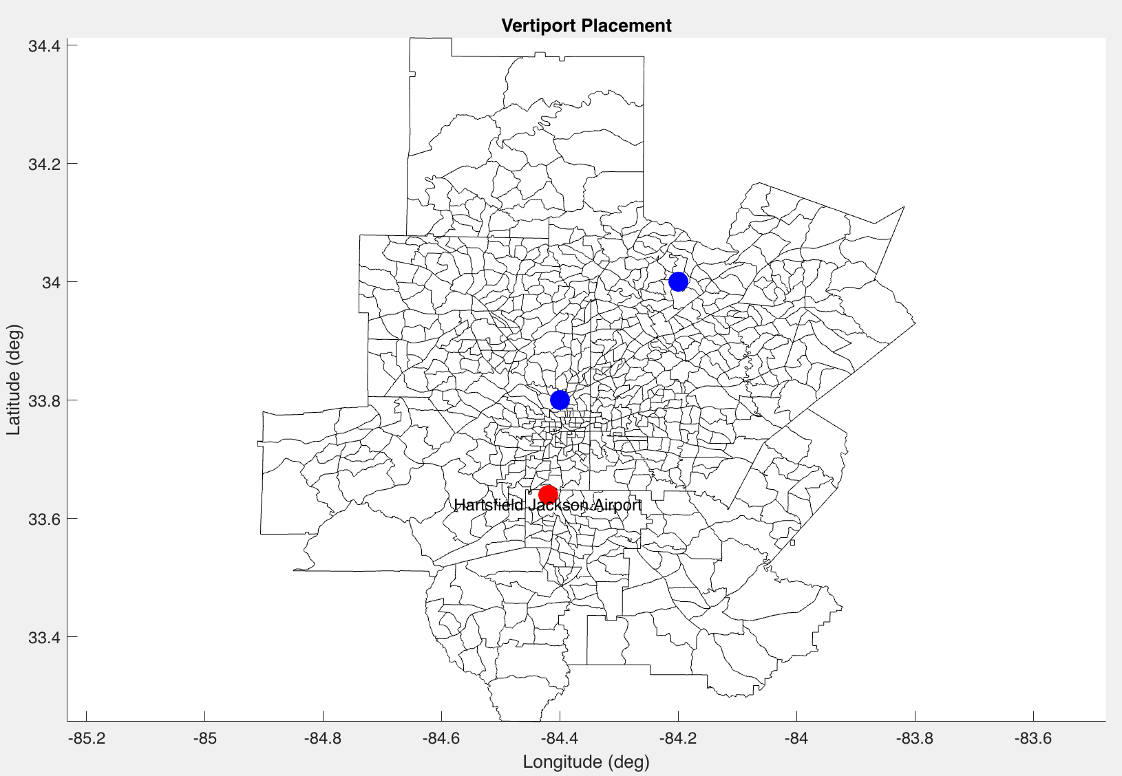
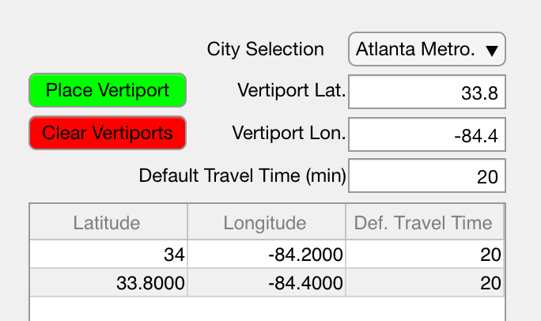
Dashboard
Motivation
Connected environment to a dashboard for decision-making support
Current Methods
4-tabbed Interface:
Vertiport
Placement
SoS
Design
Design Space
Exploration
Design
Selection
Methodology
Vertiport Placement Tab:
Implementation
User places vertiport(s) using Lat/Lon Pairs & default travel time:
Dashboard
Conclusions
Victor Petitgenet
Notes:
Paired the developed environment with a GUI to facilitate decision-making
Follows 4-tabbed layout
Vertiport placement tab allows user to place any number of vertiports using lat/lon pairs

Slide 47
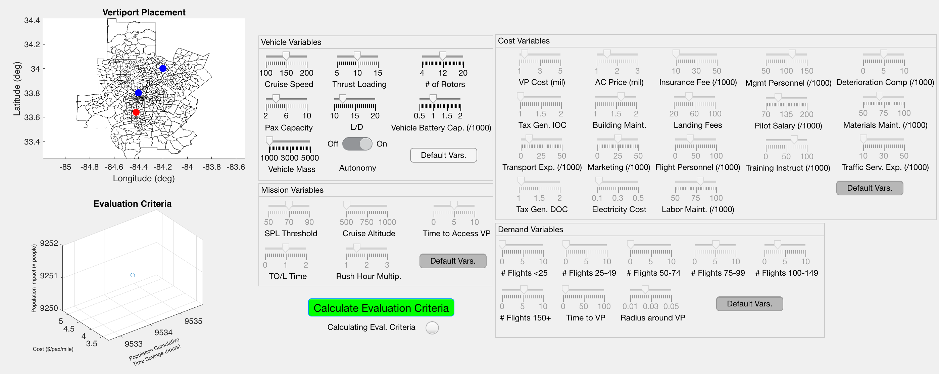
Dashboard
Motivation
SoS Design Tab:
User generates SoS design alternatives using sliders
Current Methods
Methodology
Implementation
Dashboard
Conclusions
Possibility to set variables to default values
Results for selected design shown on 3-axis plot
Victor Petitgenet
Notes:
SoS design tab gives the user the ability to design any number of SoS alternatives using the provided sliders

Slide 48
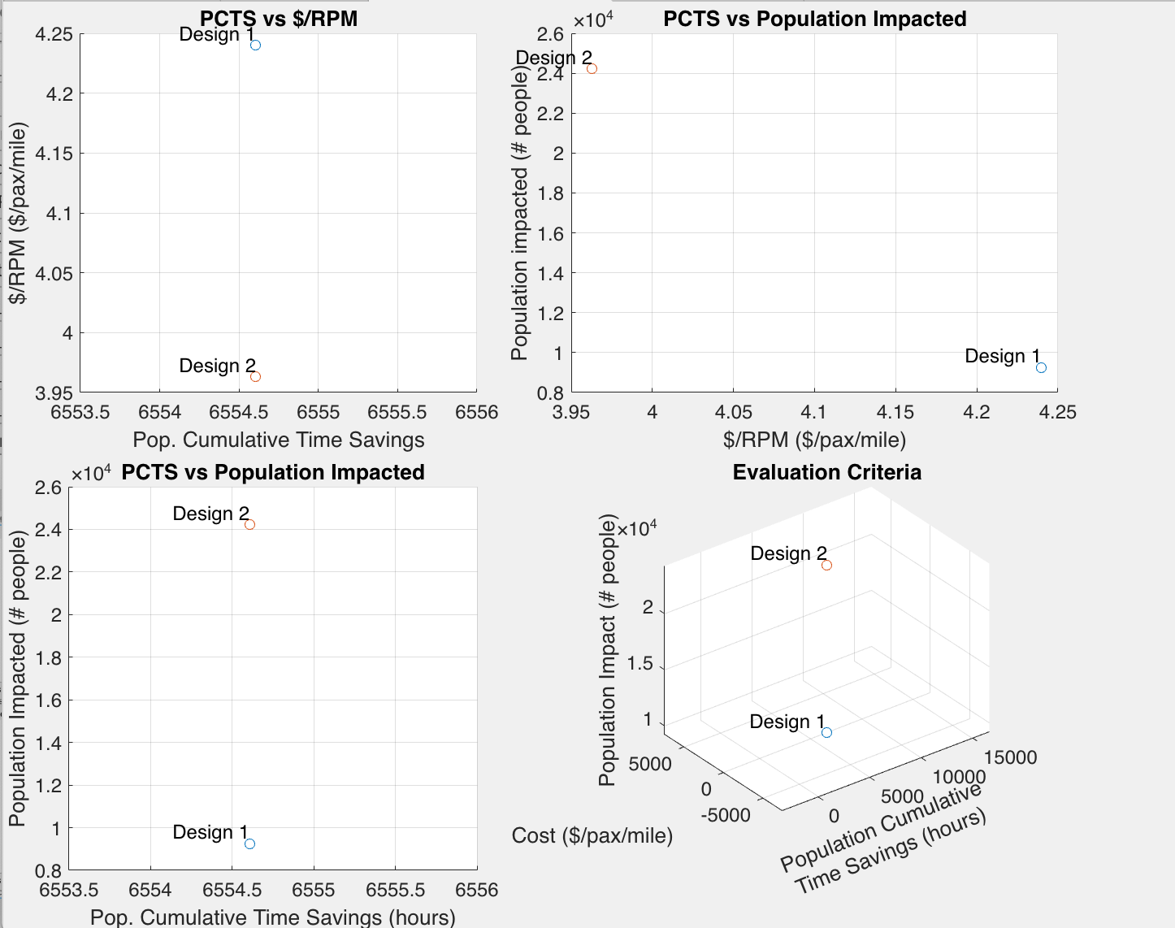
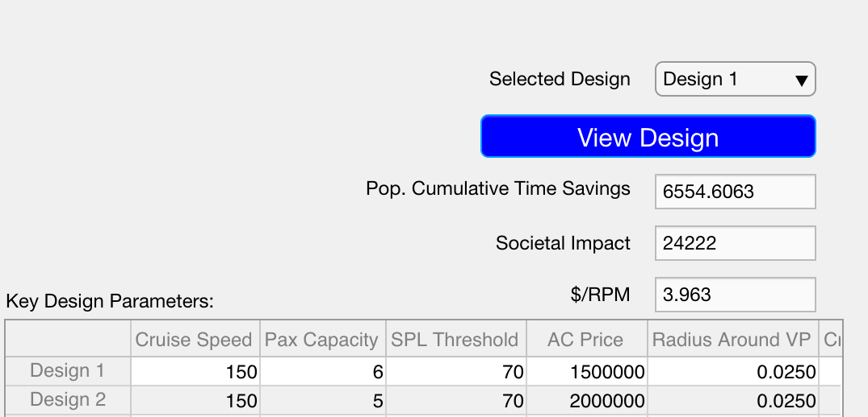
Dashboard
Motivation
Design Space Exploration Tab:
User investigates performance of SoS design alternatives
Current Methods
2D and 3D Eval. Criteria Plots:
Eval. Criteria values & Key Design Variables:
Methodology
Implementation
Dashboard
Conclusions
Victor Petitgenet
Notes:
Design Space exploration tab allows the user to visualize the performance of the different SoS alternatives from the point of view of the evaluation criteria

Slide 49
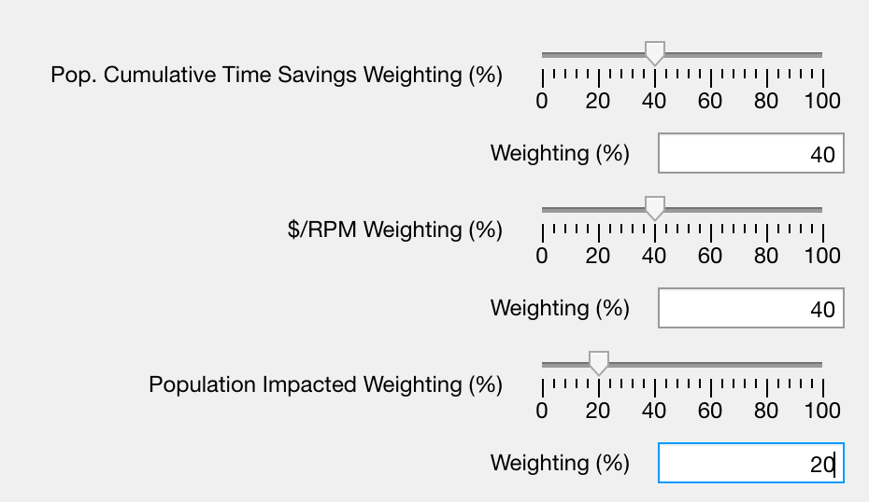
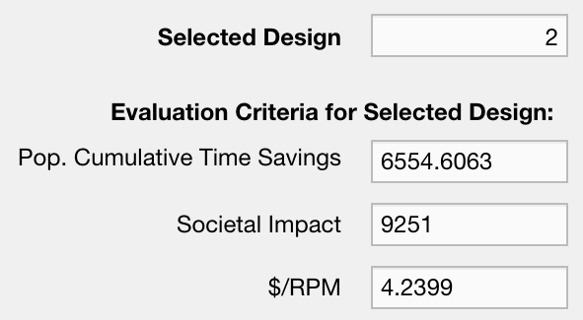
Dashboard
Motivation
Design Selection Tab:
Multi-Attribute Decision Making Technique used to recommend a SoS Design
Current Methods
User inputs weighting scheme:
Methodology
Interface recommends a design:
Implementation
Dashboard
Conclusions
Victor Petitgenet
Notes:
Design selection tab implements a MADM technique along with a user defined weighting scheme to recommend a design

Slide 50
Closing the Loop
Motivation
Developed a methodology to make an unmanageable decision-making process more manageable by intelligently restricting the design space of interest
Current Methods
Methodology
Paired with an environment and user interface that allows for comparison of different alternatives or scenarios based on evaluation criteria
Implementation
Dashboard
Make a decision regarding the SoS architecture
Conclusions
Provide insight regarding importance of 5 key UAM areas
Victor Petitgenet
Notes:
Developed a methodology to answer the original research question
Implemented this methodology for the use case of a UAM airport shuttle, able to recommend a SoS design
Also able to give insight into the sensitivities of the evaluation criteria with respect to the 5 key areas

Slide 51
References
[1] Image Credit: https://www.itsmarta.com/train-stations-and-schedules.aspx
[2] Image Credit: https://i2.wp.com/vintageairliners.com/wp-content/uploads/2015/06/tumblr_npqg5tRdbQ1skp1rlo1_1280.jpg?ssl=1
[3] Image Credit: https://i2.wp.com/vintageairliners.com/wp-content/uploads/2015/06/tumblr_npqg5tRdbQ1skp1rlo4_540.jpg?ssl=1
[4] Image Credit: https://www.uber.com/blog/new-york-city/uber-copter/
[5] https://maloney.house.gov/media-center/press-releases/reps-maloney-nadler-velazquez-introduce-legislation-to-address-nyc-s
[6] VTOL Urban Air Mobility Concept Vehicles for Technology Development
[7] Environment Impact on Feasibility of Sub-Urban Air Mobility using STOL Vehicles
[8] Door-to-Door Travel Time Comparative Assessment for Conventional Transportation Methods and Short Takeoff and Landing On Demand Mobility Concepts
[9] Progress in Vertiport Placement and Estimating Aircraft Range Requirements for eVTOL Daily Commuting
[10] Image Credit: https://blade.flyblade.com
[11] Image Credit https://www.bellflight.com/products/bell-nexus
[12] Image Credit https://www.volocopter.com/en/
[13] Image Credit https://lilium.com/
[14] Briceno, Simon. "Urban Air Mobility: What is it and how soon?" Georgia Airports Association Annual Conference and Exposition, September 2019, Jekyll Island Convention Center, Jekyll Island, GA.
[15] https://www.asdl.gatech.edu/ARCHITECT.html
[16] https://www.airbus.com/careers/working-for-airbus/innovations-of-tomorrow.html
[17] VertiportPlacementForeVTOLCommuting.pdf
[18] A Vehicle Demand and Optimization Model for On-Demand Aviation (Brown and Harris)

Slide 52
Backup

Slide 53
Common Inputs to Evaluation Criteria
Motivation
Decomposition of evaluation criteria yielded common inputs
Current Methods
Origin / Destination
( Latitude – Longitude pairs)
Region
(Urban area of interest)
Methodology
Vehicle Characteristics
(Cruise Speed, Range, Capacity…)
Accessibility
(Acceptable distance around vertiports)
Implementation
Mission Profile / Operations
(Sortie Rate, Turnaround Time…)
Affordability
(Income level of target population)
Dashboard
Default Method of Transportation
(comparison with train, automobile, …)
Route Type
(Airport Shuttle, Air Taxi, etc)
Conclusions
Need to determine values/methods to generate values for these common inputs
Victor Petitgenet

Slide 54
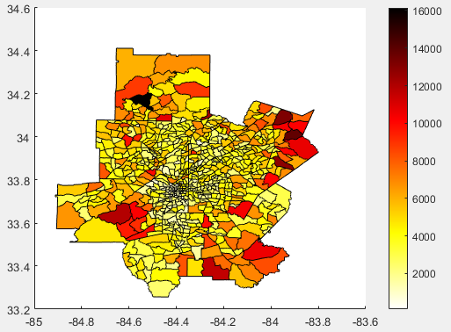

Input Data Sources – Demand
Motivation
Demand modelling incorporates census and economic data
Current Methods
Household Income level (x1000) | Average Flights per year (2017)
<25 | 1.0
25-49 | 0.9
50-74 | 1.7
75-99 | 5.1
100-149 | 3.2
>150 | 5.4
Methodology
Implementation
Dashboard
Conclusions
Census Data
Economic Surveys
Demand mapped to geographic area

Slide 55
Input Data Sources – Performance
Motivation
Performance modelling uses existing/upcoming vehicles to estimate values
Current Methods
Vehicle | Max Range | Speed | Capacity | Energy Source
Bell Nexus | 130 nm | 155 kts | 4+1 | Hybrid Electric
Volocopter X2 | 14.5 nm | 55 kts | 2+0 | Electric
A³ Vahana | 54 nm | 125 kts | 2+0 | Electric
Aurora Flight Sciences PAV | 43 nm | 97 kts | 2+0 | Electric
Pipistrel 801 | 52 nm | 152 kts | 4+1 | Electric
Karem Butterfly | 73 nm | 130-175 kts | 4+1 | Electric
Joby S4 | 130 nm | 120 kts | 4 | Electric
Airbus CityAirbus | 16 nm | 65 kts | 4 | Electric
Methodology
Input ranges for performance parameters bounded by realistic values
Implementation
Dashboard
Conclusions
Victor Petitgenet

Slide 56
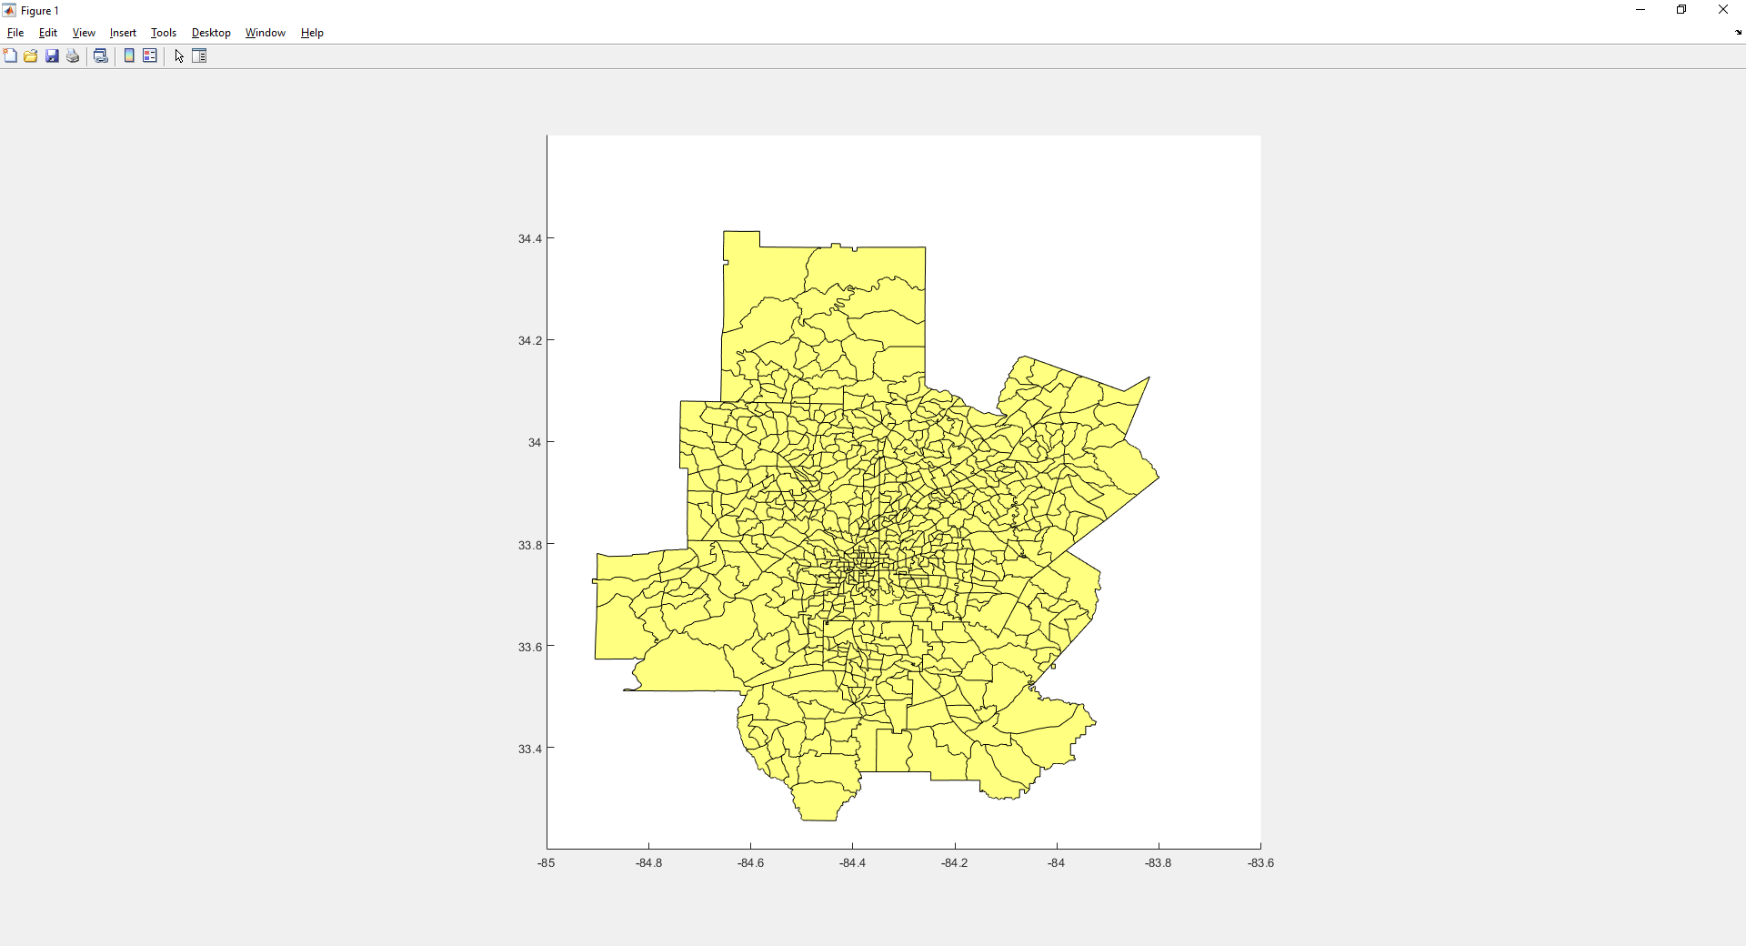
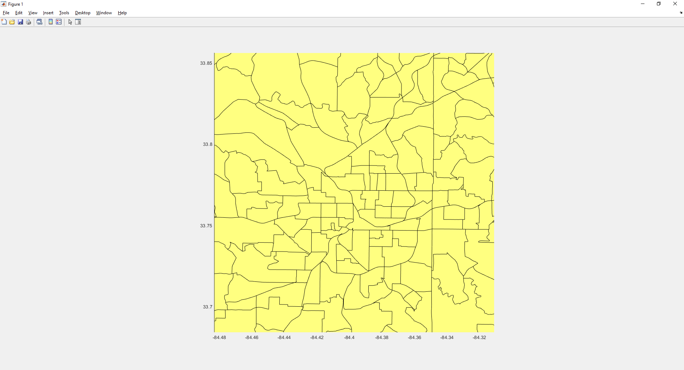
Time Savings Module
Motivation
Quantify time savings by comparing travel times with/without UAM networks
Takeoff
Landing
Current Methods
X₁ min
X₂ min
X₃ min
X₄ min
Getting to VP
Cruise Segment
Methodology
Area served by VP
Region GIS/Census Data
Implementation
Time Savings Module
Origin / Destination Points
Population Cumulative Time Savings
Vehicle Characteristics
To other modules:
Dashboard
Direct point-to-point flight
Demand per Income Level
Number of Required Vehicles
Total Number of Flights
Conclusions
Default Travel Time (without UAM)
Flight Distances
Calculates time savings as a function of geographical/population data and vehicle specs
Victor Petitgenet

Slide 57
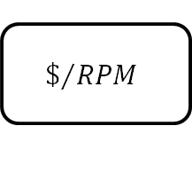
Cost Module
Motivation
Using $/RPM as a proxy for the cost to the consumer
Vertiport
Current Methods
Vehicle Characteristics
Laborers
Laborers
DOC
Module
IOC
Module
General Taxes
Methodology
General Taxes
Landing Fees
Materials/Deterioration Maintenance
Vehicle
Implementation
# of Vehicles from Time Savings Module
Insurance
Vehicle Characteristics
Flight Distances from Time Savings Module
Demand per Income Level
$$\$/{RPM}$$
Dashboard
# Seats
Distance
Load Factor
Conclusions
Calculates $/RPM as a function of DOC, IOC, Number of Seats, Distance, and Load Factor

Slide 58






Societal Impact Module
Motivation
Quantify societal impact by counting number of people exposed to at least a given noise level
Current Methods
Methodology
Vehicle Noise Output
Ground Track
Vortex noise is the primary noise source for an eVTOL vehicle
Implementation
Leverage previously developed noise model^{[18]}
Constant | $$K_{2}$$
Rotor Tip Speed | $$V_{T}$$
Air Density | $$ρ$$
# of Rotors | $$N$$
Thrust (= Weight) | $$T$$
Rotor Solidity | $$s$$
Thrust Loading | $$T/A$$
Dashboard
Vehicle Characteristics
$$SPL=20\log\left[K_{2}\frac{V_{T}}{ρ\left(∆S\right)}\sqrt{\frac{NT}{s}\left(\frac{T}{A}\right)}\right]$$
Conclusions
Distance
$$∆S$$
Able to calculate noise SPL as function of distance for given vehicle
Victor Petitgenet

Slide 59

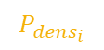
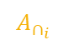
Societal Impact Module
Motivation
Defining a SPL threshold and altitude gives a radius of impact for the vehicle
Current Methods
Methodology
Pair with flight path to find noise “footprint”
R
Implementation
Dashboard
$$\# Impacted=\sum_{i=1}^{n}{round\left[A_{∩_{i}}∗P_{{dens}_{i}}\right]}$$
Conclusions
$$A_{∩_{i}}$$
Area of intersection between footprint and i^{th} planning region
$$P_{{dens}_{i}}$$
Population density of i^{th} planning region
Victor Petitgenet

Slide 60
Environment Details
Motivation
Region
(Urban area of interest)
Current Methods
Origin / Destination
( Latitude – Longitude pairs)
Env. Impact
Methodology
Mission Profile / Operations
(Sortie Rate, Turnaround Time…)
Static Implementation
Sensitivity
Analysis
Cost
Time Savings
Route Type
(Airport Shuttle, Air Taxi, etc)
Evaluation Criteria
Implementation
Vehicle Characteristics
(Cruise Speed, Capacity…)
X %
Accessibility
(Acceptable distance around vertiports)
Analysis Environment
X %
Dashboard
Affordability
(Income level of target population)
X %
X %
Default Method of Transportation
(comparison with train, automobile, …)
Research and Calibration Data
Conclusions
X %
X %
SoS Sensitivities
Victor Petitgenet

Slide 61
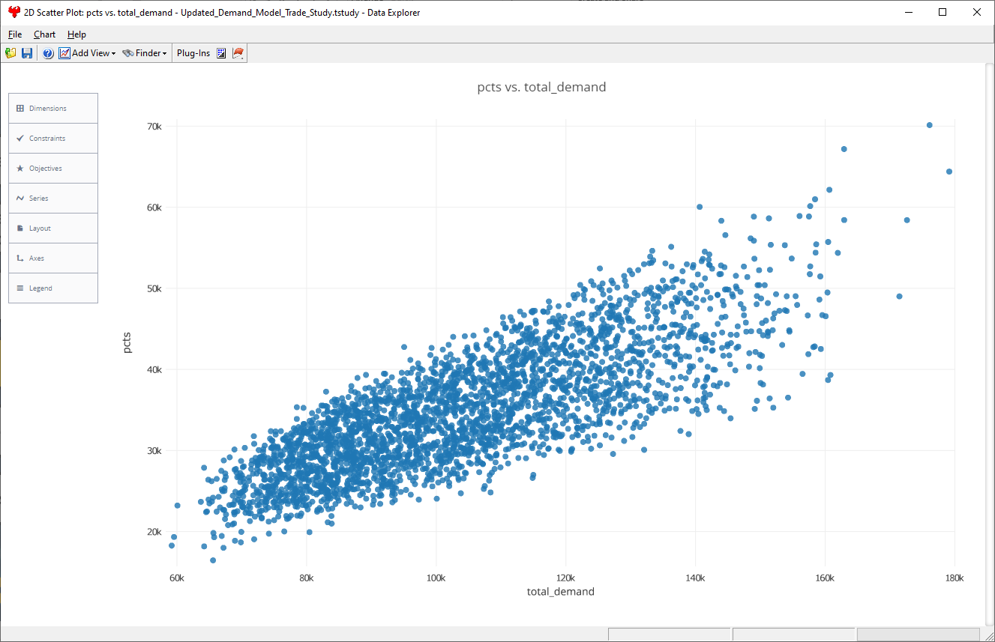
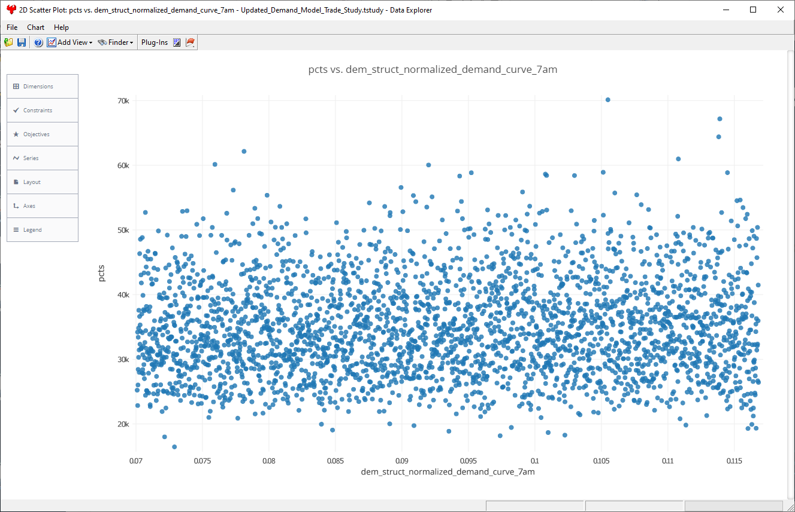
Results from Updated Demand Model
Motivation
Overall demand for flights unchanged…
…But lower-level design variables have less impact on time savings overall
Current Methods
Methodology
PCTS
PCTS
Implementation
Dashboard
Conclusions
Demand
Normalized demand at 7 AM
Lower-level variables in demand model prove to be less sensitive
Victor Petitgenet

